Slide 1
RASD Requirement Analysis & Specification Document
Authors:
_Giancarlo Colaci
_Giulio De PASQUALE
_Francesco Rinaldi
ProJect:
_PowerEnjoy
Supervisor:
_Elisabetta di nitto

Slide 2
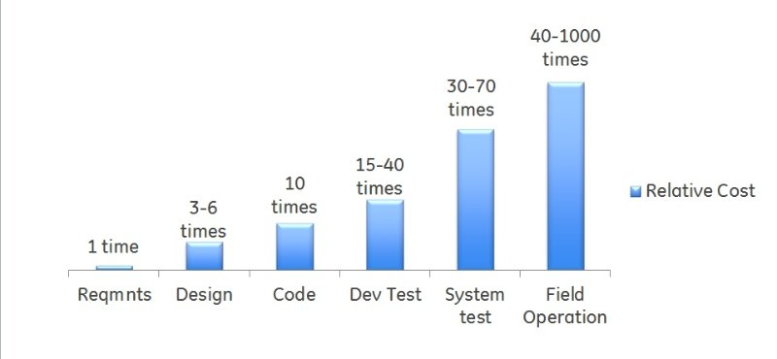
The Document
This document belongs the first phase of the Waterfall Model of Software Development: the Requirement Phase. It is very important because errors made in understanding requirements have the potential for greatest cost, because many other design decisions depend on them.
[The cost of correcting an error depends on the number of subsequent decisions that are based on it.]
Illustration of the relative impact of requirement errors.

Slide 3



Actors Identifying
Guest: a person that has never signed up to the system. He can only sign up, view available cars and contact the customer service.
User: a person already registered in the system who can log in and use all the functionalities described. Unless specified, each user is active: therefore he / she can use the service with no restrictions.
Deactivated user: a user with revoked privileges. He/she cannot use the service until the issues with his/her account are solved. (e.g., expired license)

Slide 4

Domain Properties
The user will only provide correct and authentic information while signing up.
The user will never try to exploit the system’s features (e.g. sleep in the car).
The user will never fake his/her position to cause a denial of service.
The user will request help only if he/she needs it.
The user will never let another person drive the car he/she reserved.
The user will never be robbed of the access credentials and the verification code.
The user will agree and respect our terms of use (e.g. to be geolocalized)
Glossary:
Verification code: it is a code that adds another level of security to our service:
the user will need it to unlock the car.

Slide 5


Domain Properties
Each car has an embedded key to turn on the engine;
Each available car is fully functional thanks to the MES;
Each car is equipped with a properly wortking ADS and an ECS;
Each car is fitted with a properly working notification touchscreen display;
Each seat is equipped with a sensor which is used to detect the number of passengers into each car;
Glossary:
ADS: Auto Diagnosis System, an always on embedded peripheral which continuously monitors the status of the car (e.g. battery charge, tires pressure, impact detection)
ECS: Emergency Call System, an always on embedded peripheral which can be used to call the consumer service or an emergency number quickly
MES: Maintenance External Service, it is an external service that takes care of ordinary or extraordinary car maintenance.

Slide 6
Assumptions
Due to some unclear points in the specification we made some assumptions, which are:
The system allows users to locate any car in PowerEnjoy’s area of operation;
The system’s Money Saving Option has to be enabled or disabled during registration or in the user profile;
The system permits users to reserve an available car only in his/her city: with "a certain geographical region" we mean that the user can reach the vehicle in a reasonable amount of time;
The system can locate its users in some way: for example, through Cellular Data or GPS;
The system can check the proximity of the user to the reserved car: for example, through a numerical code printed on each cars’ windshield or through GPS data from user’s phone;
The rental fees are applied as soon as one of these conditions is met: one minute is elapsed from the car’s doors opening, or the engine is revved; (otherwise the user could stay within the car for free)
Each user can’t reserve more than one car at the same time;
To be eligible for the 10% discount, almost two passengers have to remain seated at the same time for at least one minute;
If the user will leave the car in a special recharging area, taking care of plugging it into the power grid, the discount will be greater than 30%: for example, we suppose 40%.

Slide 7
Privileges: Guest
Register to the system by creating a new account;
Check available cars’ position and status;
Contact the customer service.

Slide 8


Slide 9
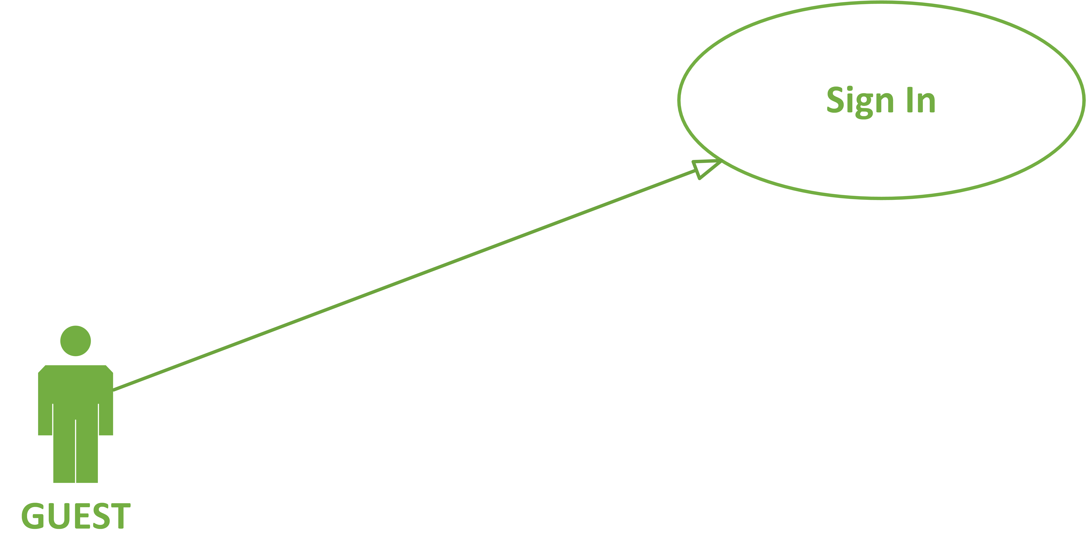

Slide 10
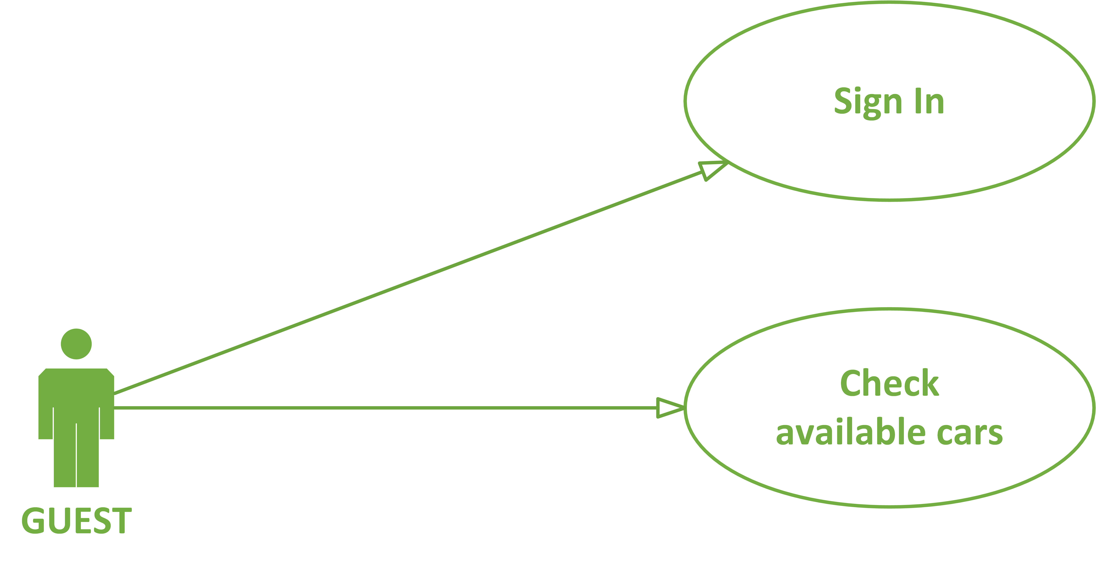

Slide 11
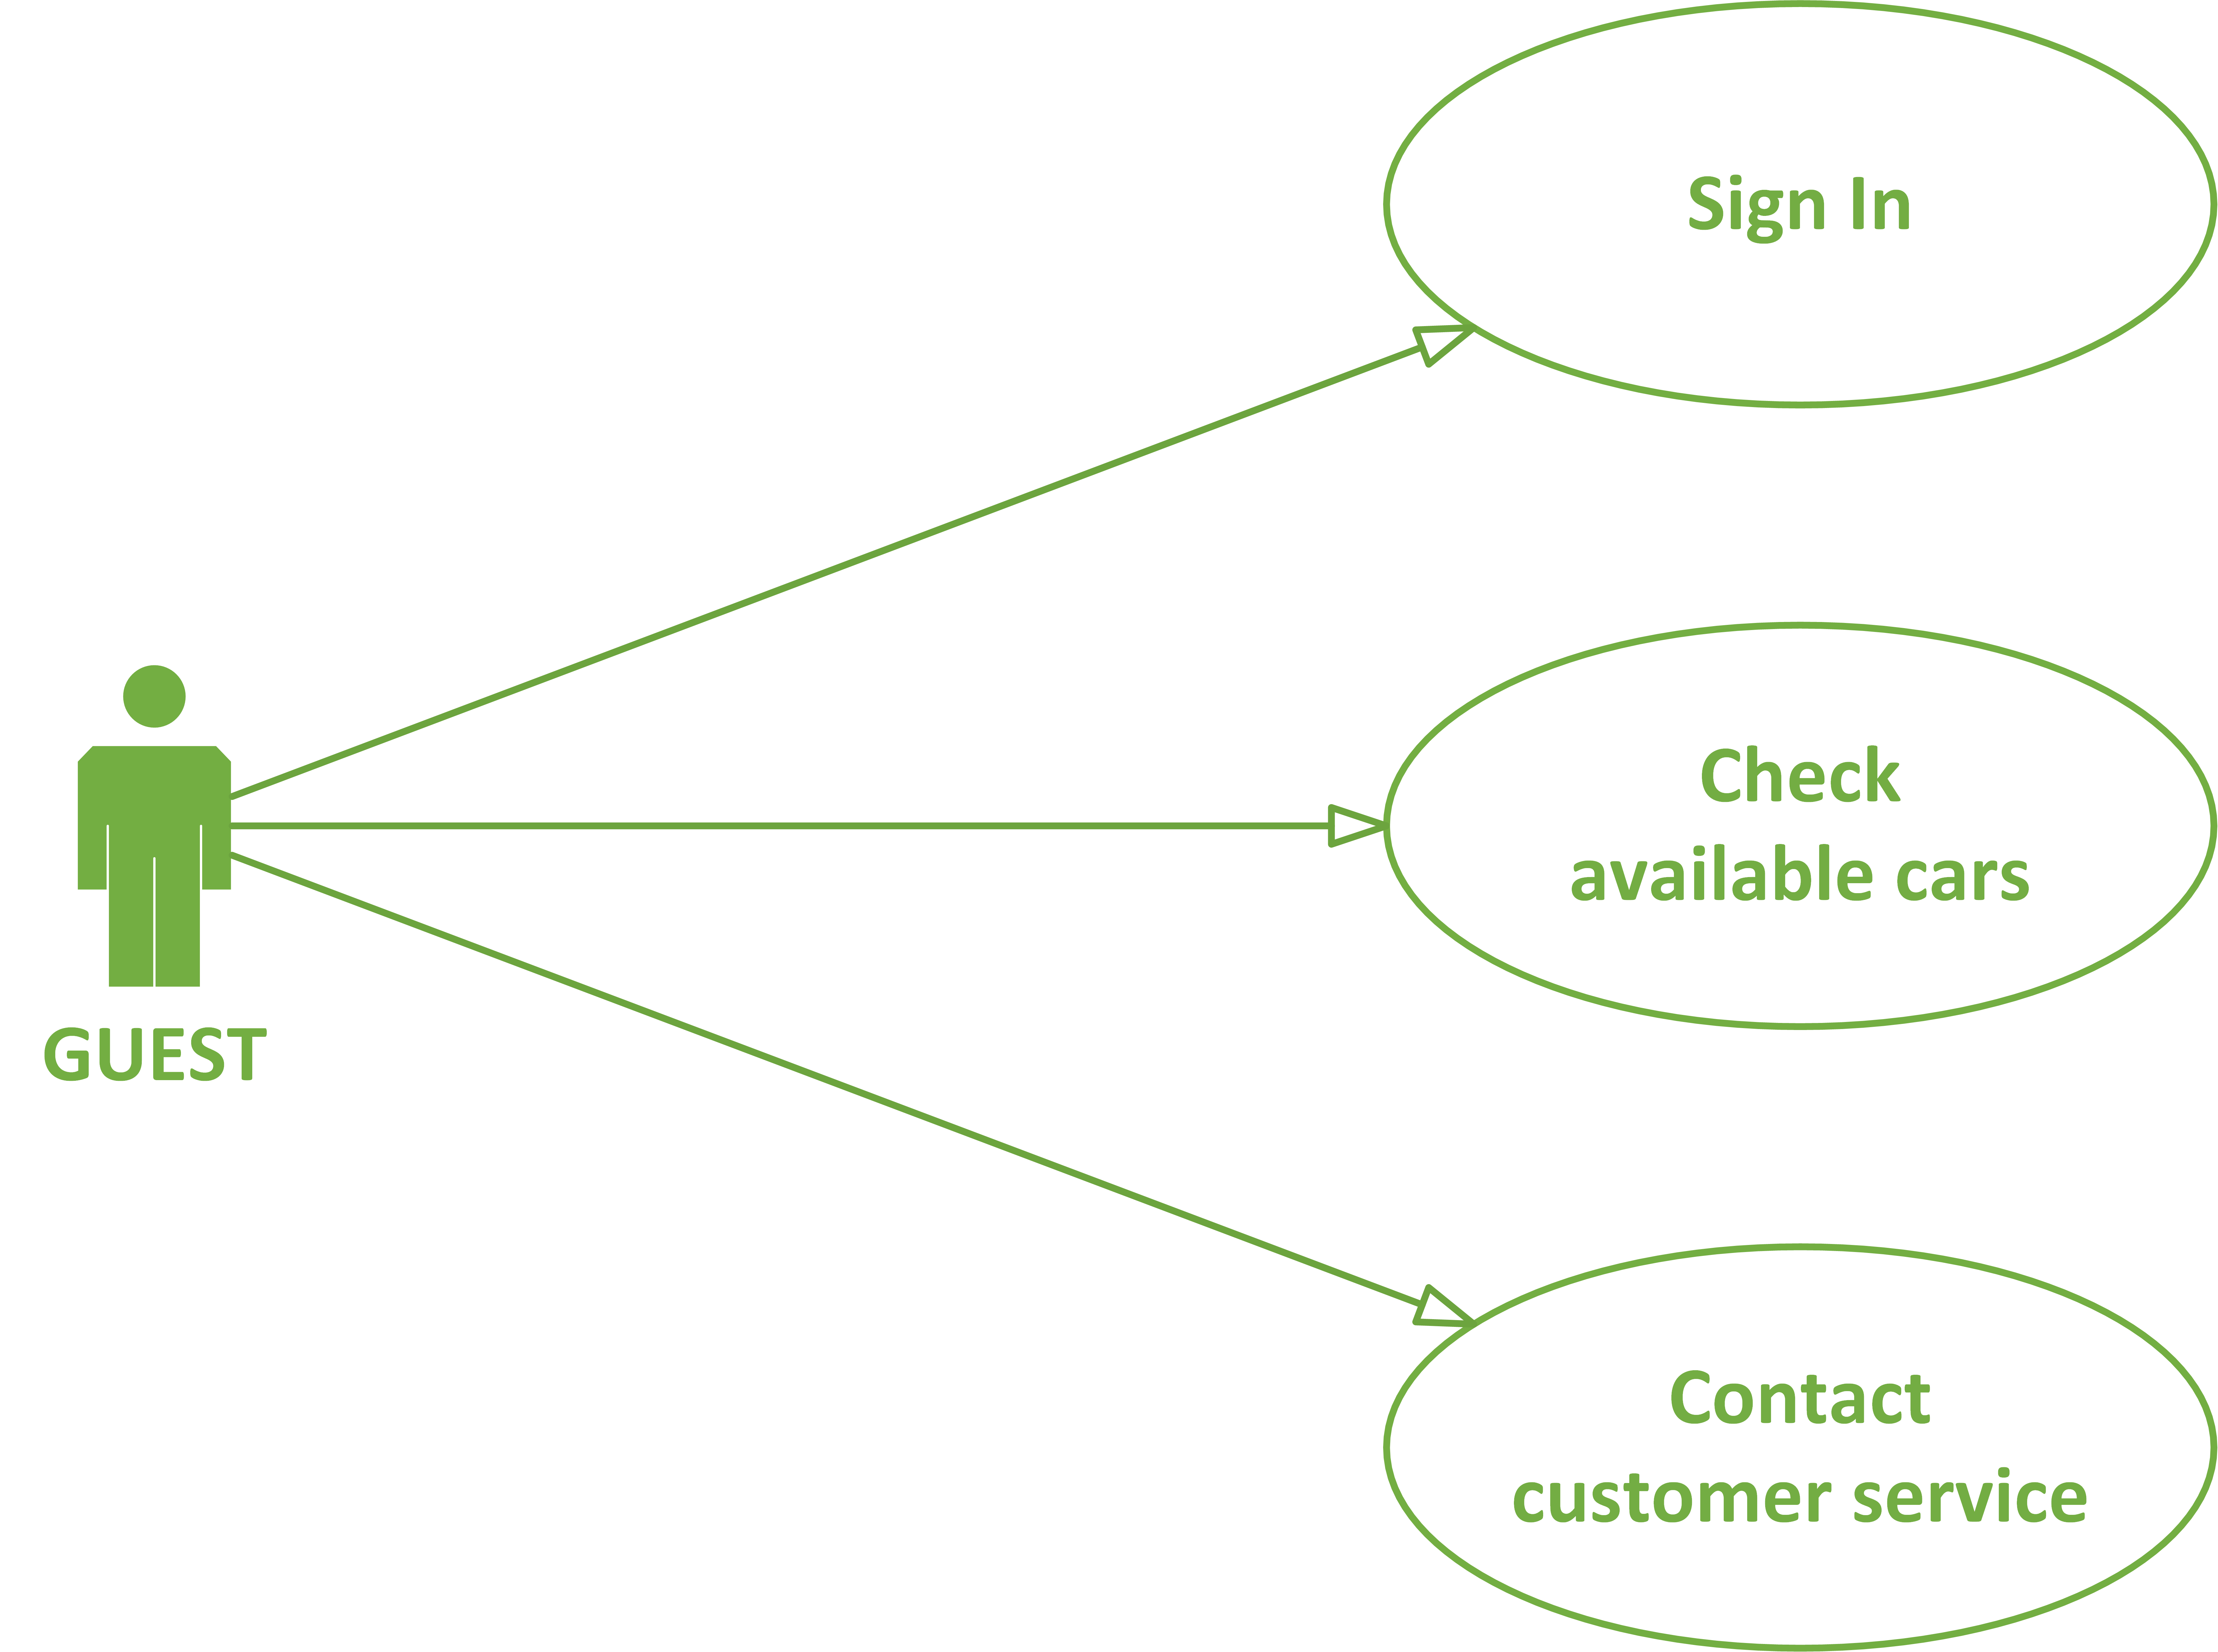

Slide 12
Privileges: User
Log into the system;
Consult reservations’ history;
Edit account information:
– personal and billing data; – enable/disable Money Saving Option;
Check available cars’ position and status;
Reserve a reservable car;
Rent the reserved car;
Check active reservation status:
– Remaining time until the reservation expires;
– Reserved car’s position and status;
– Elapsed rental time;
Terminate the rent;
Contact the customer service.

Slide 13


Slide 14
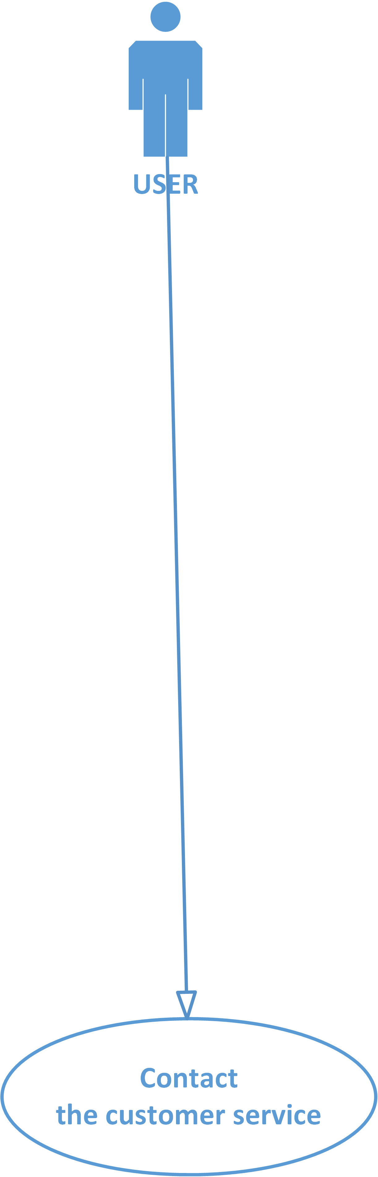

Slide 21
Privileges: Deactivated User
Log into the system;
Consult reservations’ history;
Edit account information:
– personal and billing data; – enable/disable Money Saving Option;
Check available cars’ position and status;
Reserve a reservable car;
Rent the reserved car;
Check active reservation status:
– Remaining time until the reservation expires;
– Reserved car’s position and status;
– Elapsed rental time;
Terminate the rent;
Contact the customer service.

Slide 22


Slide 23
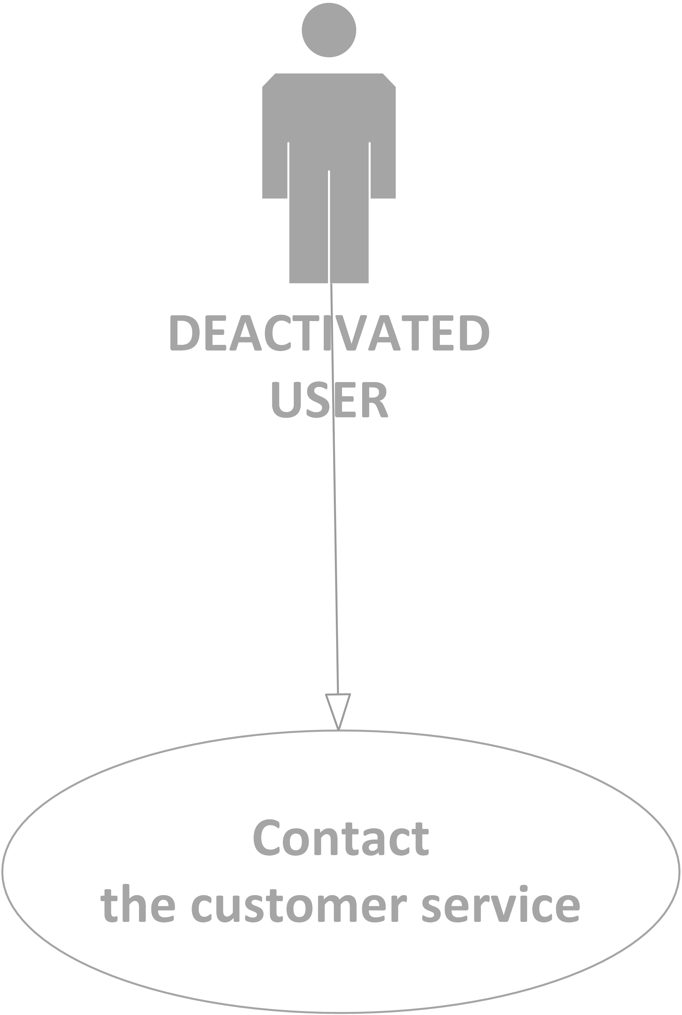

Slide 27
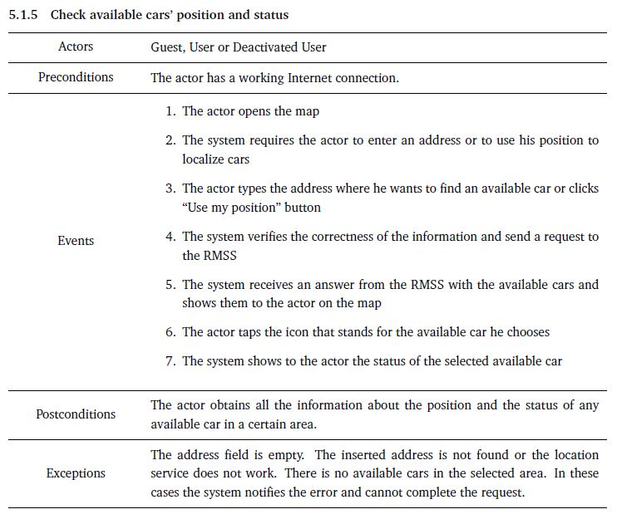

Slide 28
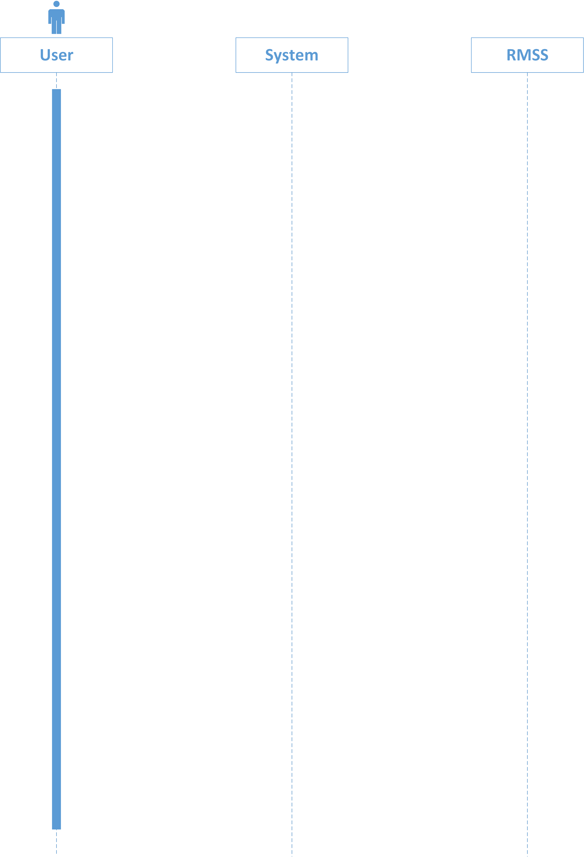

Slide 29
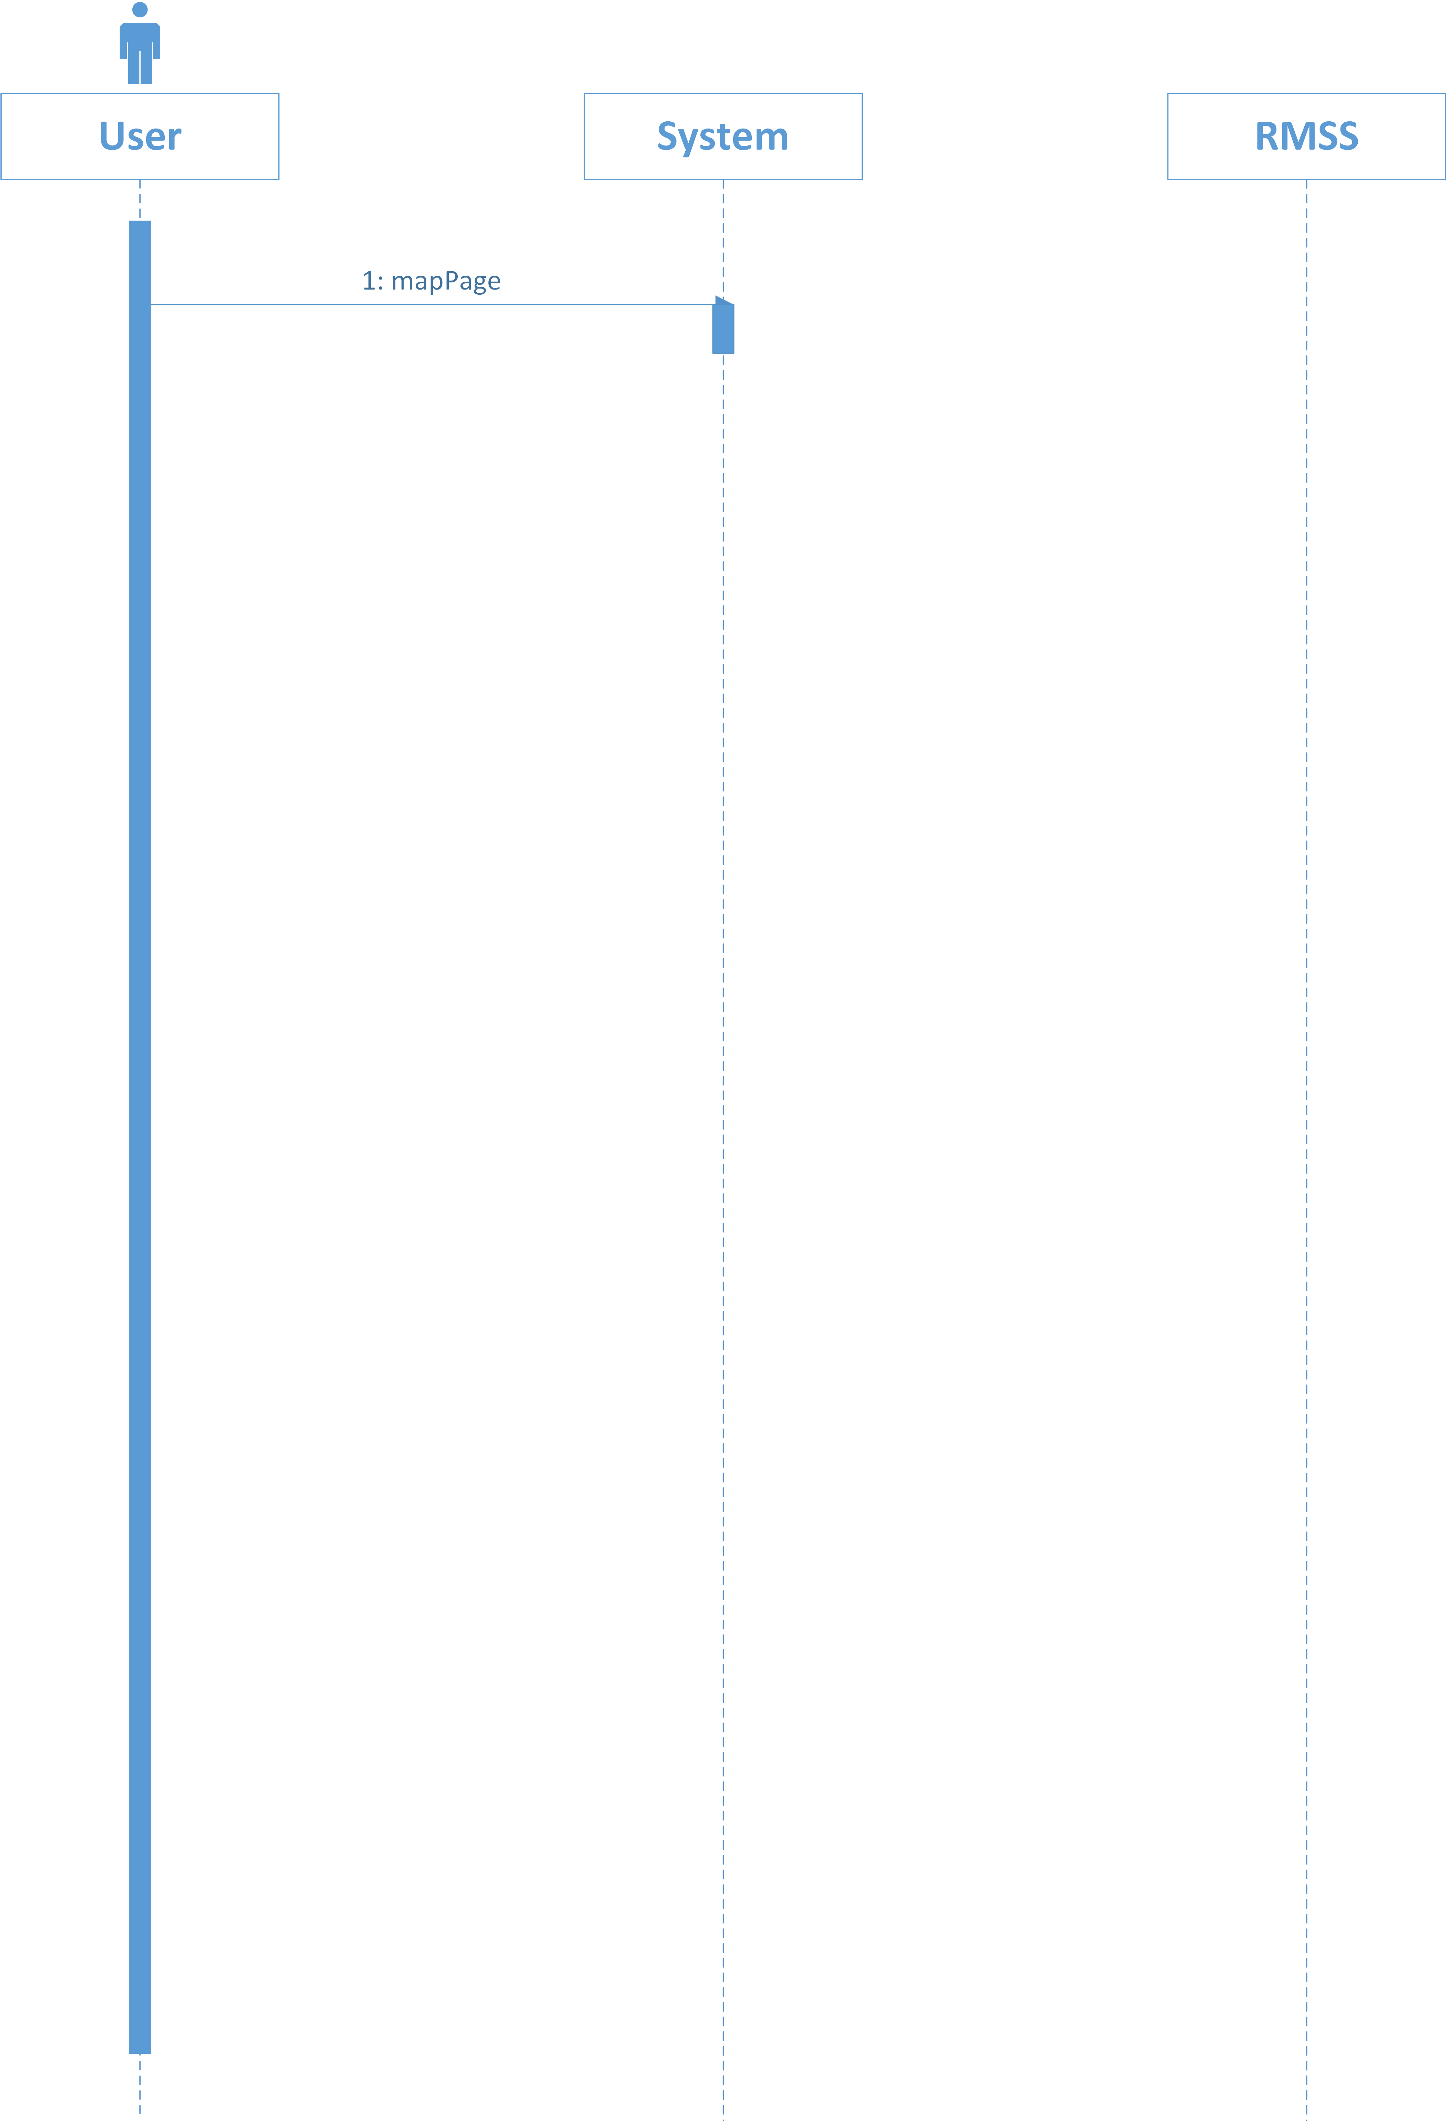

Slide 30
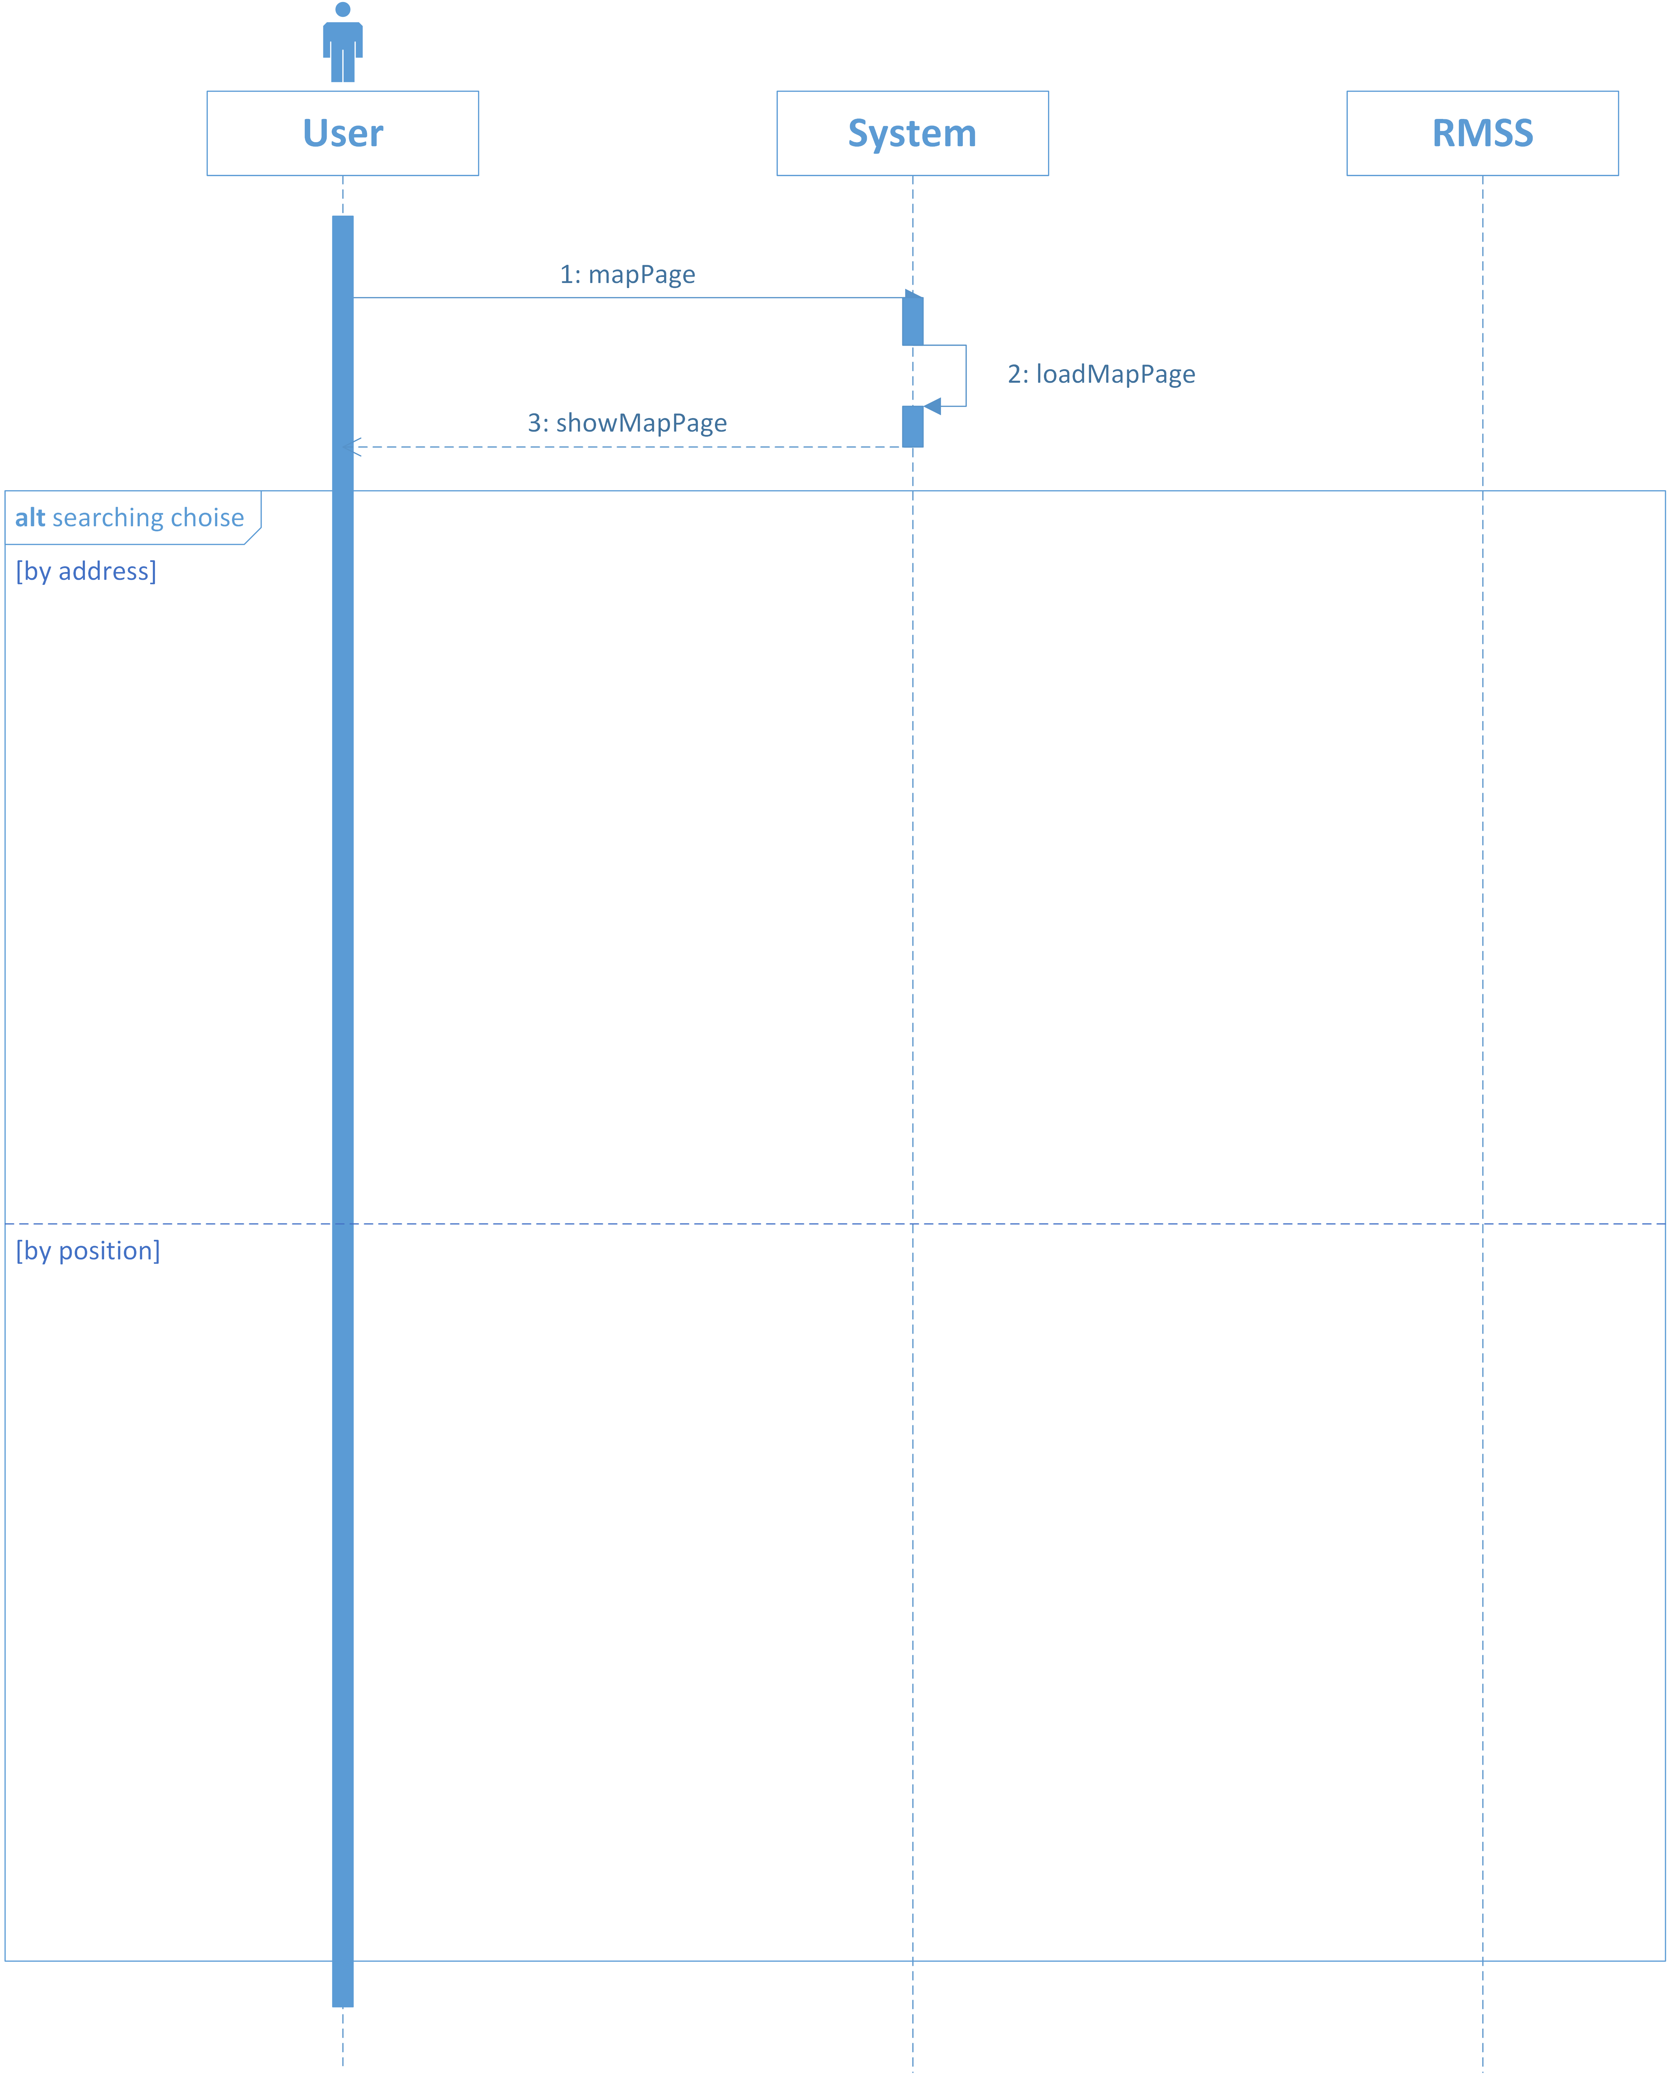

Slide 31
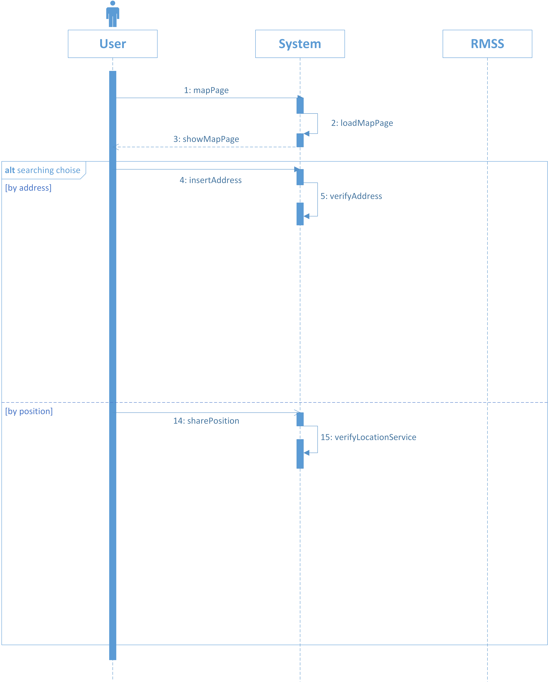

Slide 32
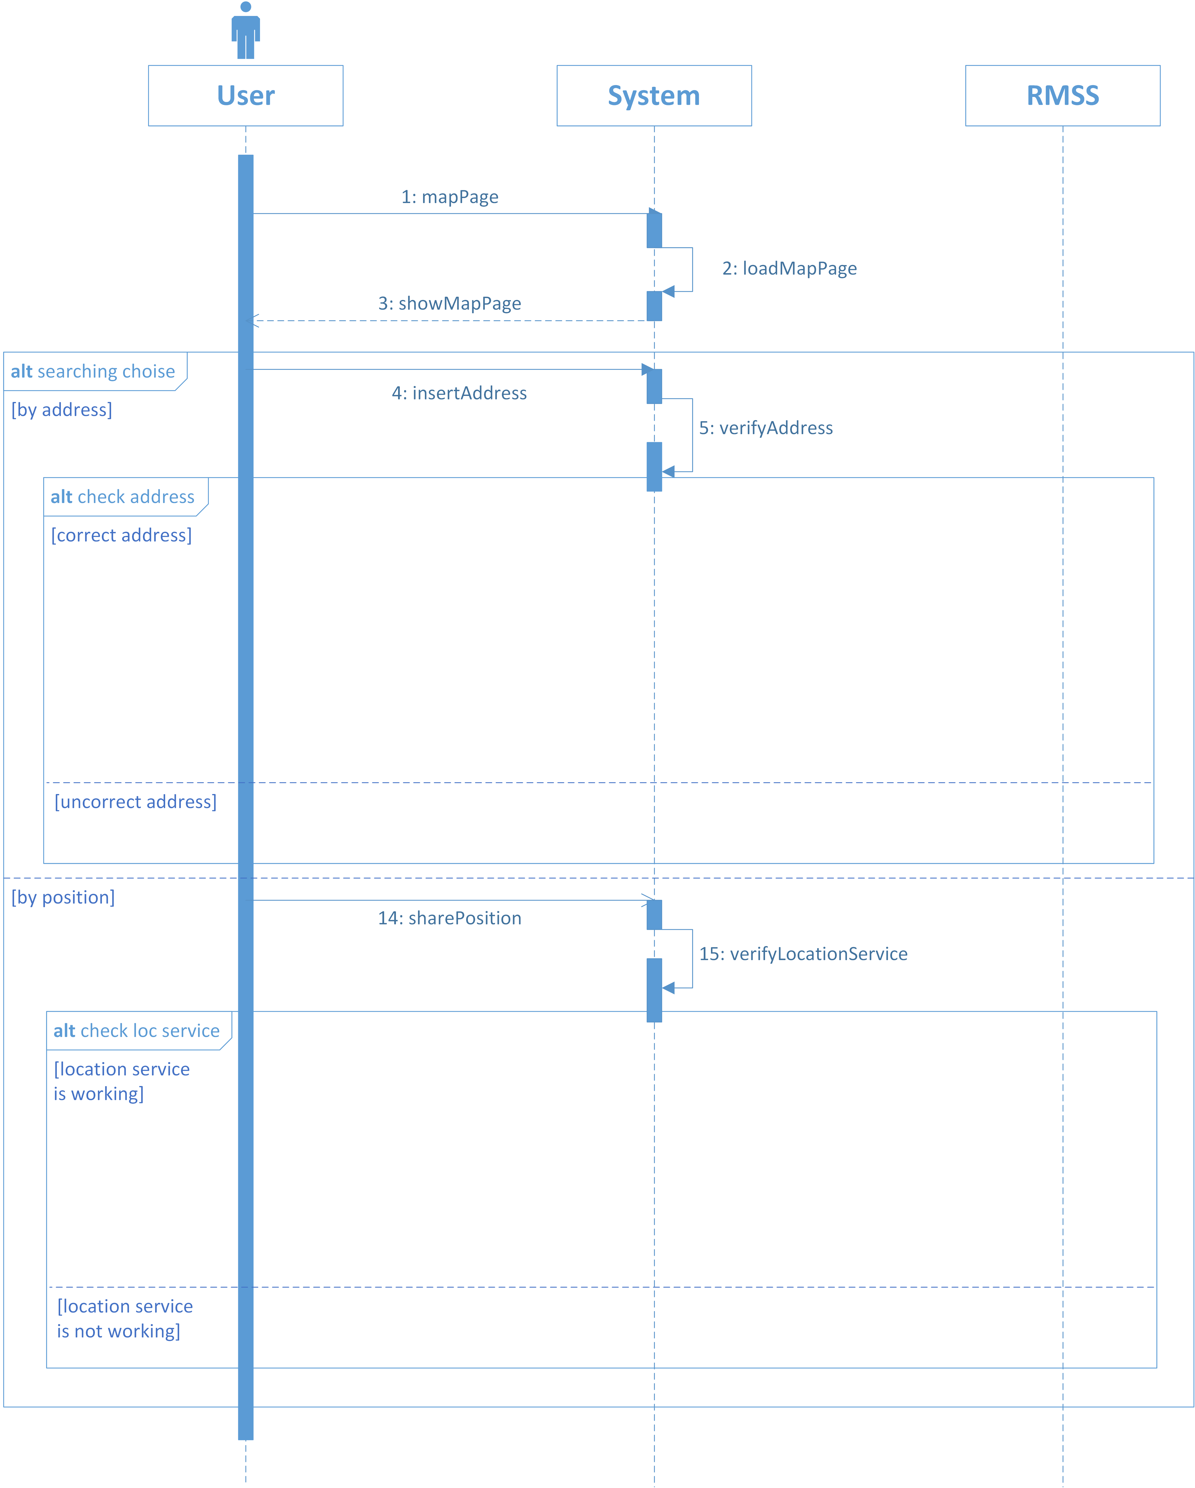

Slide 33
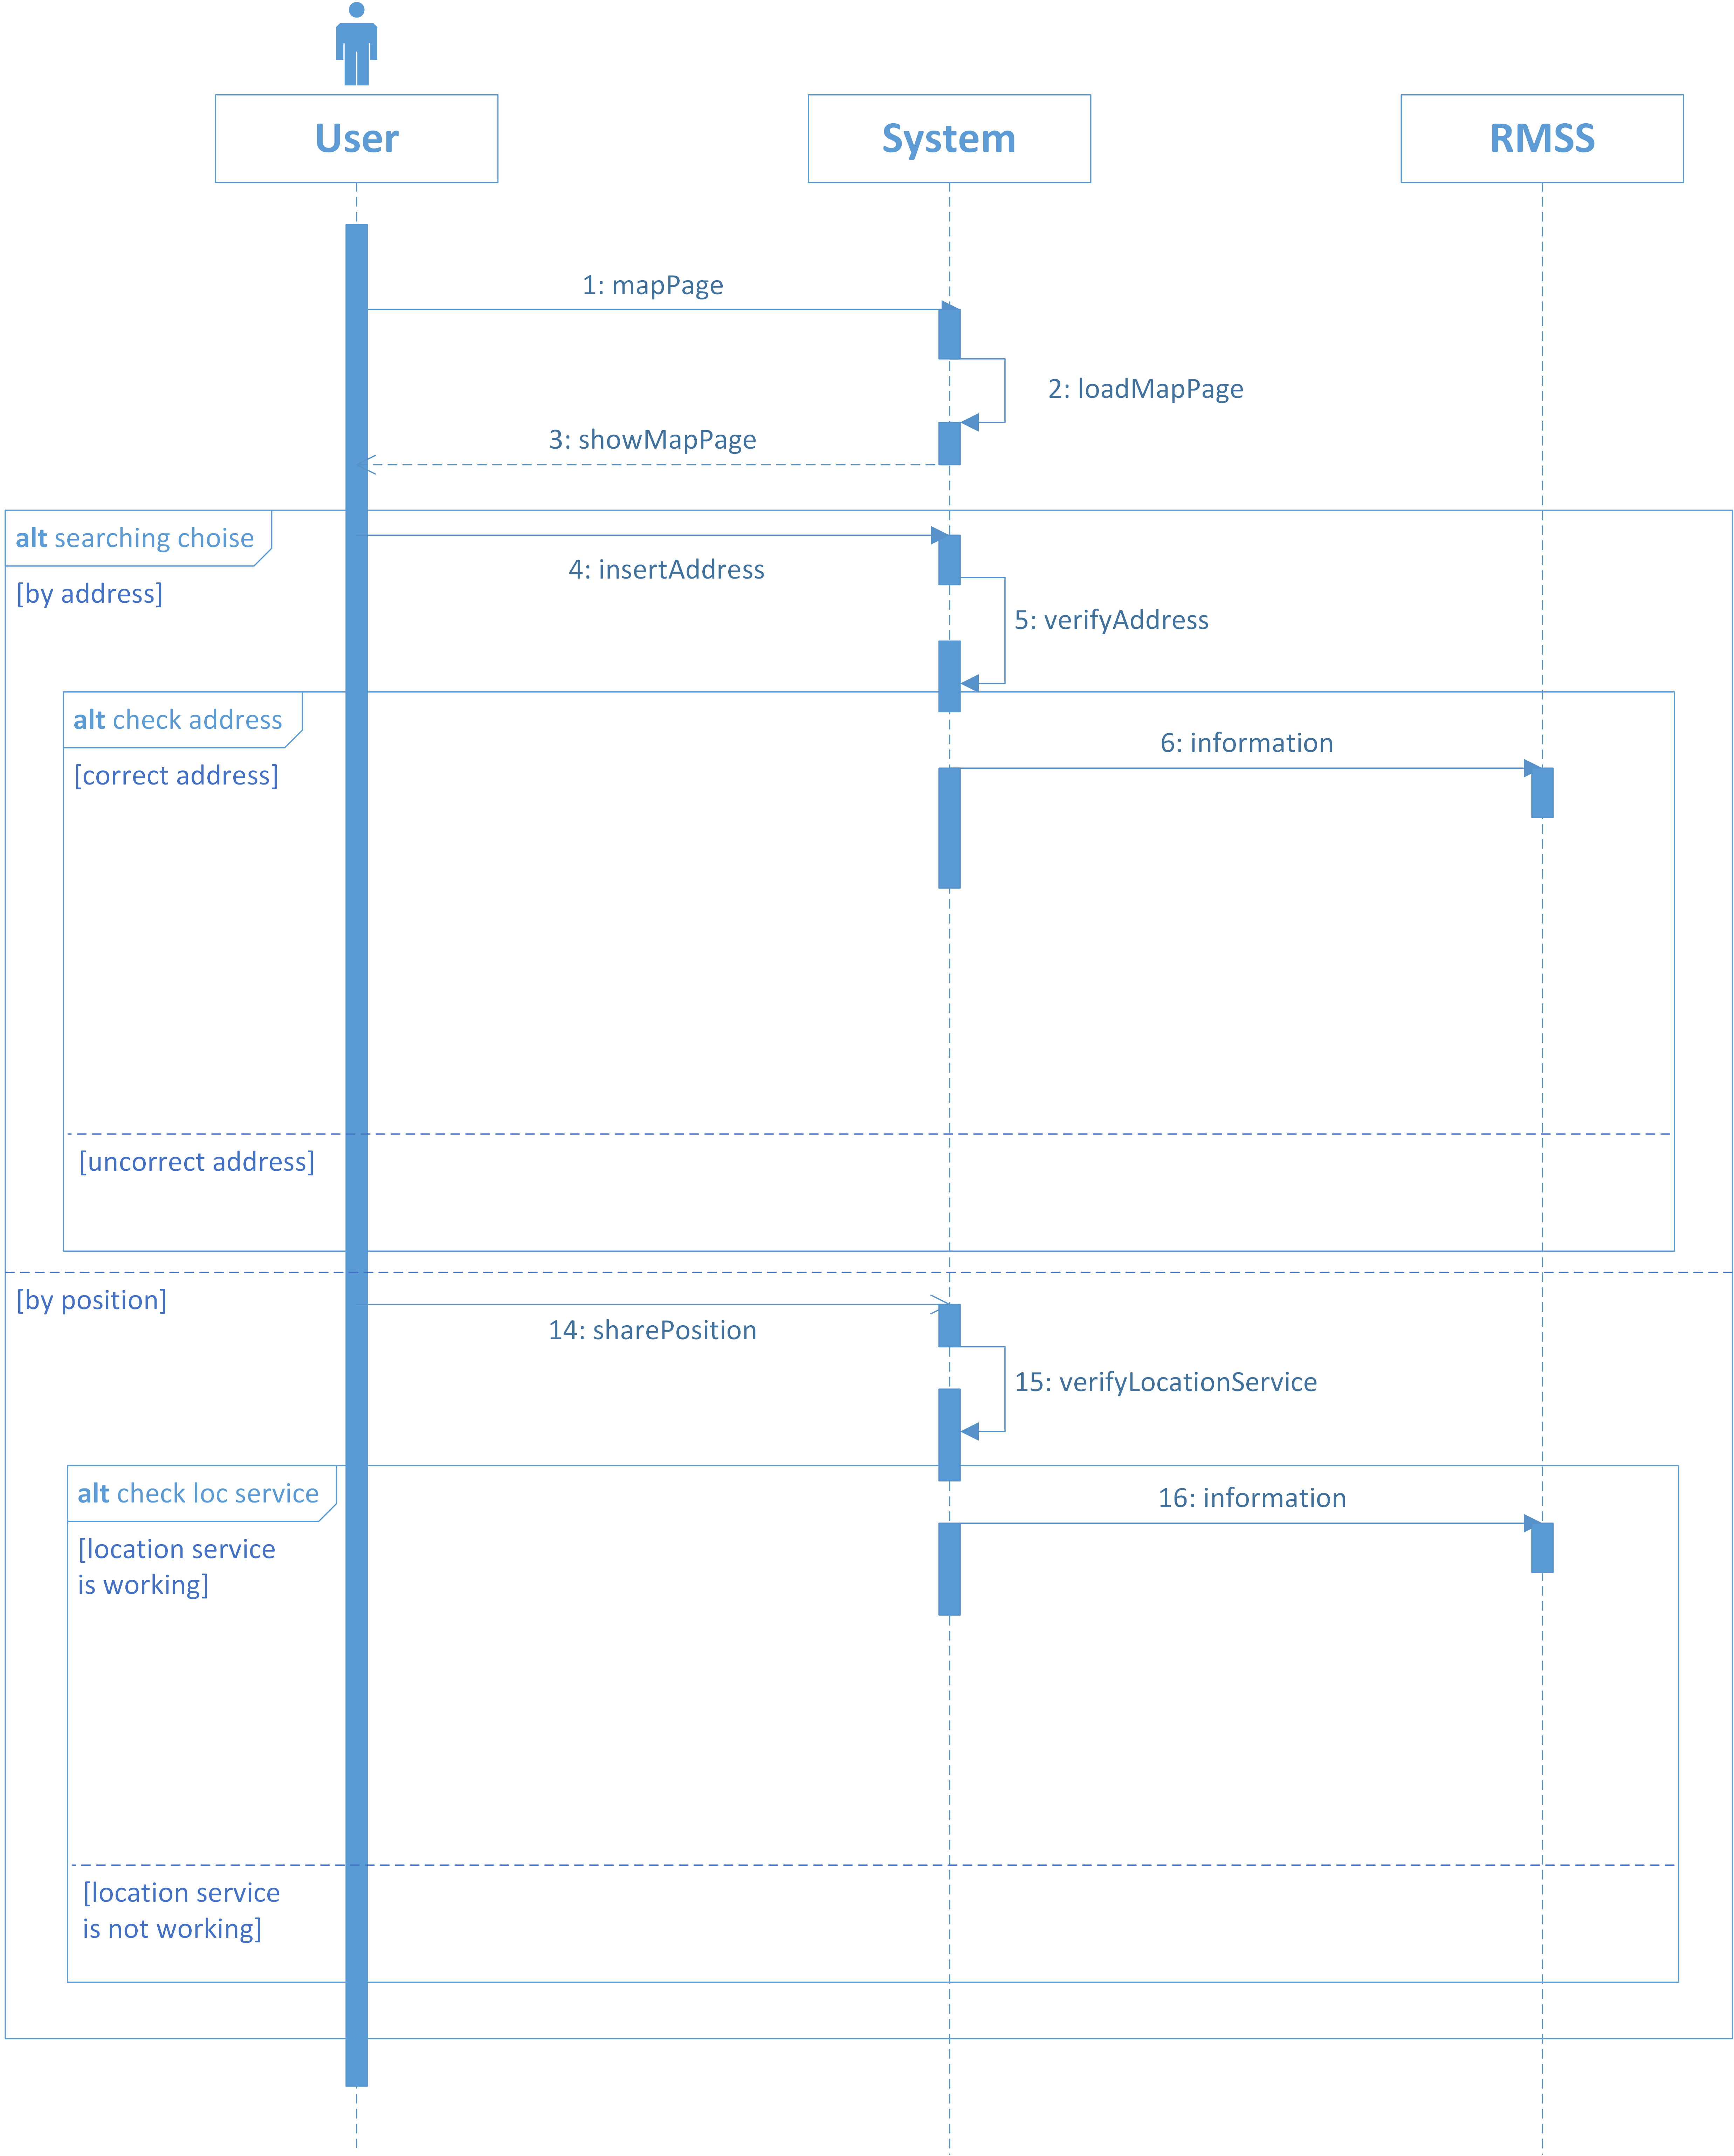

Slide 34
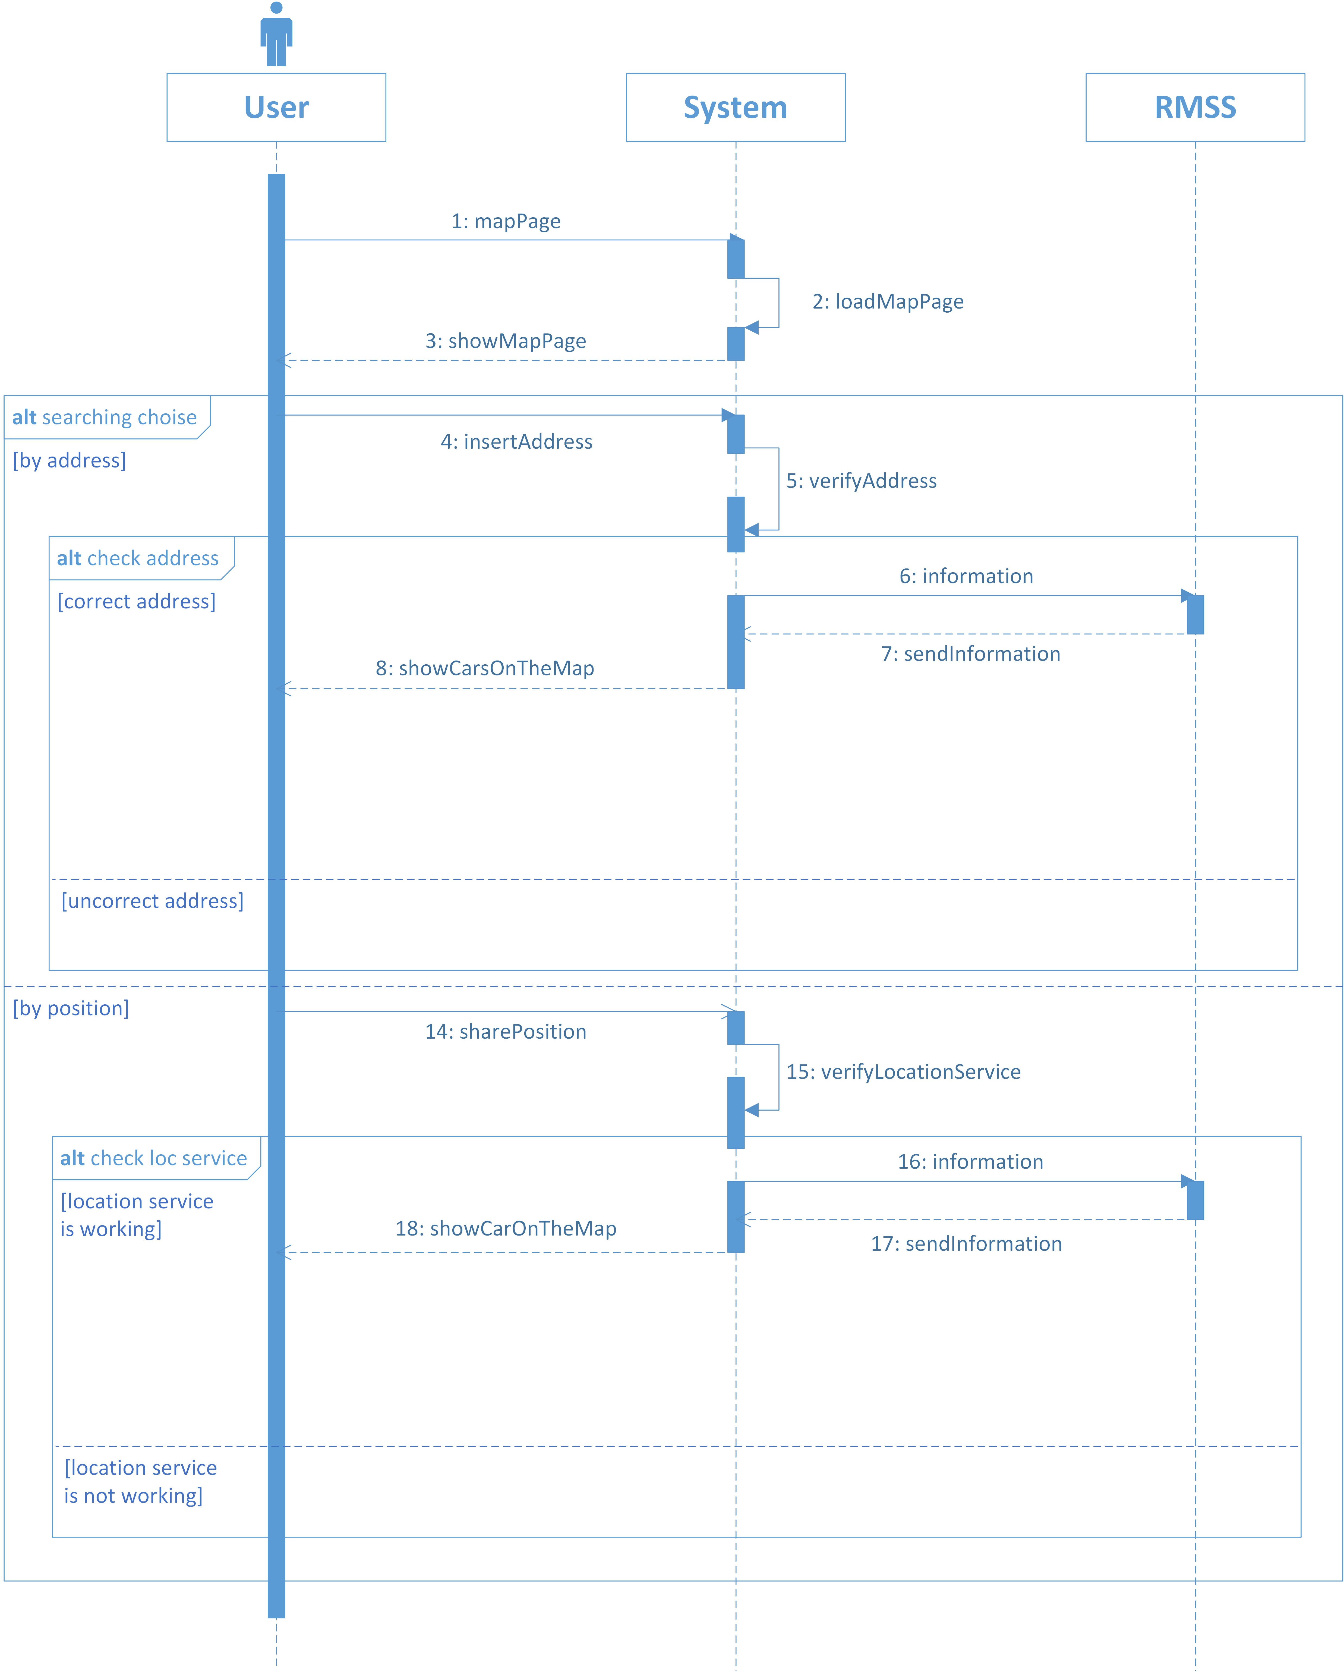

Slide 35
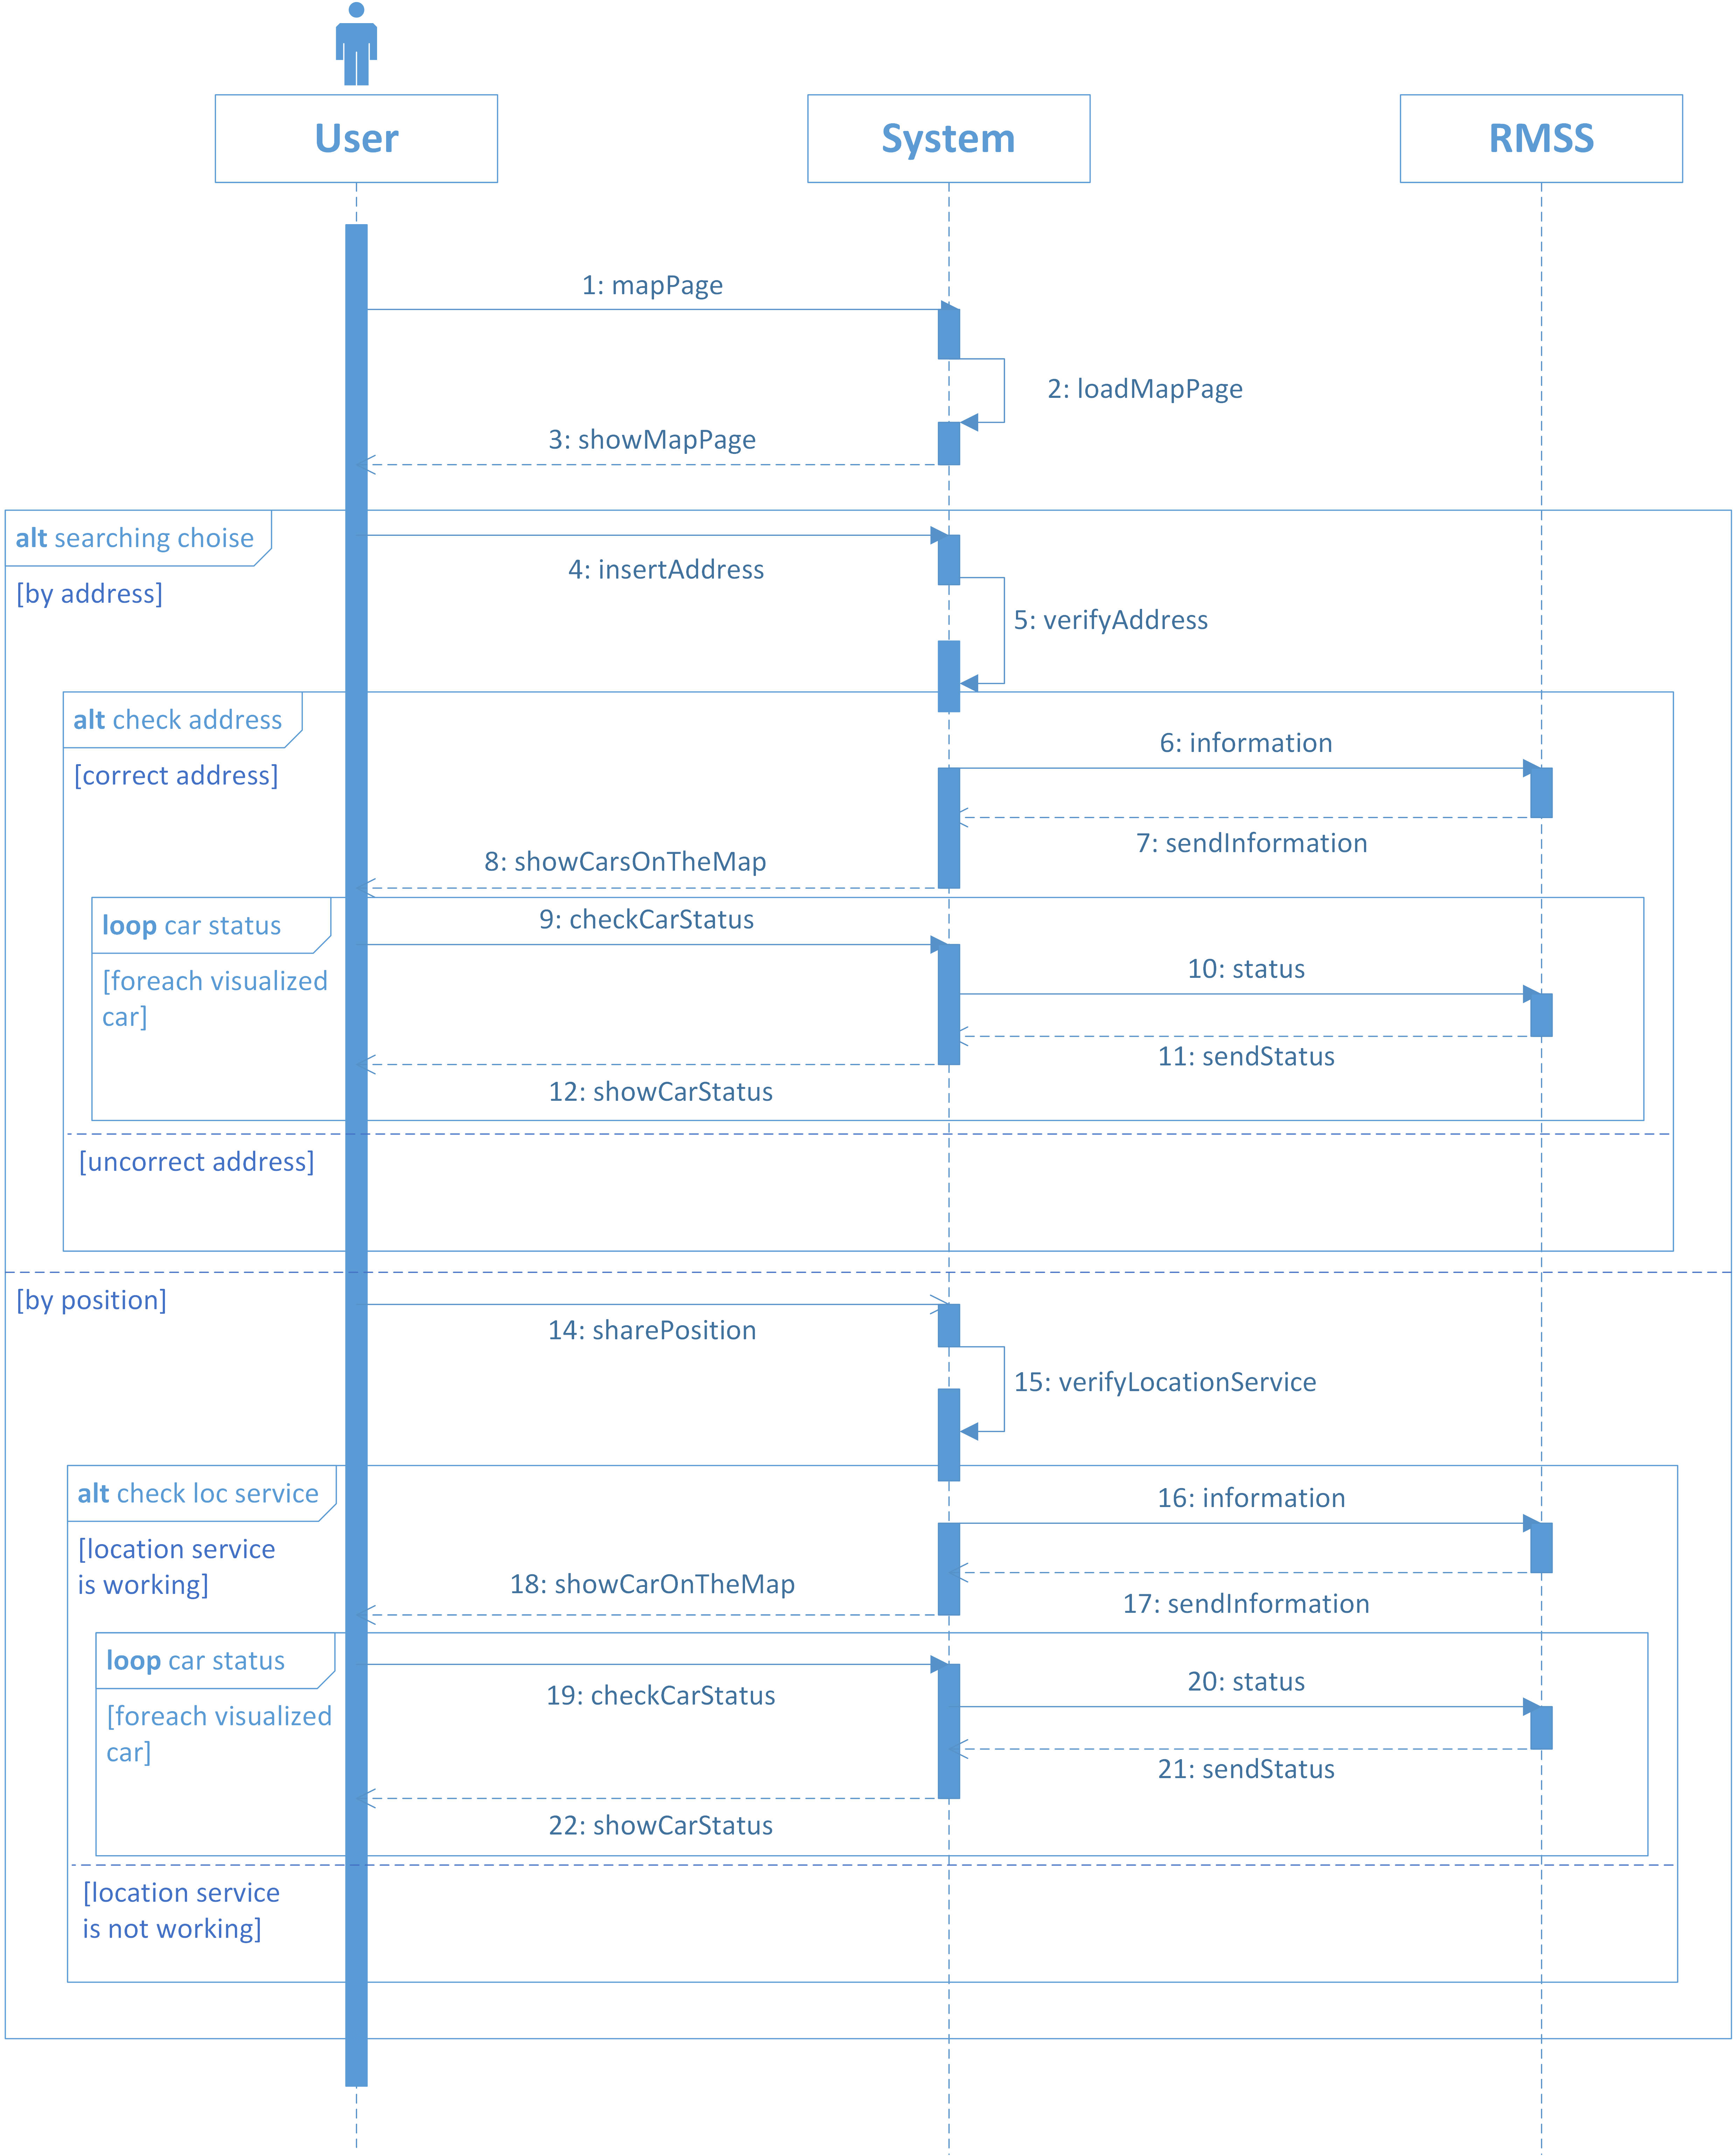

Slide 36
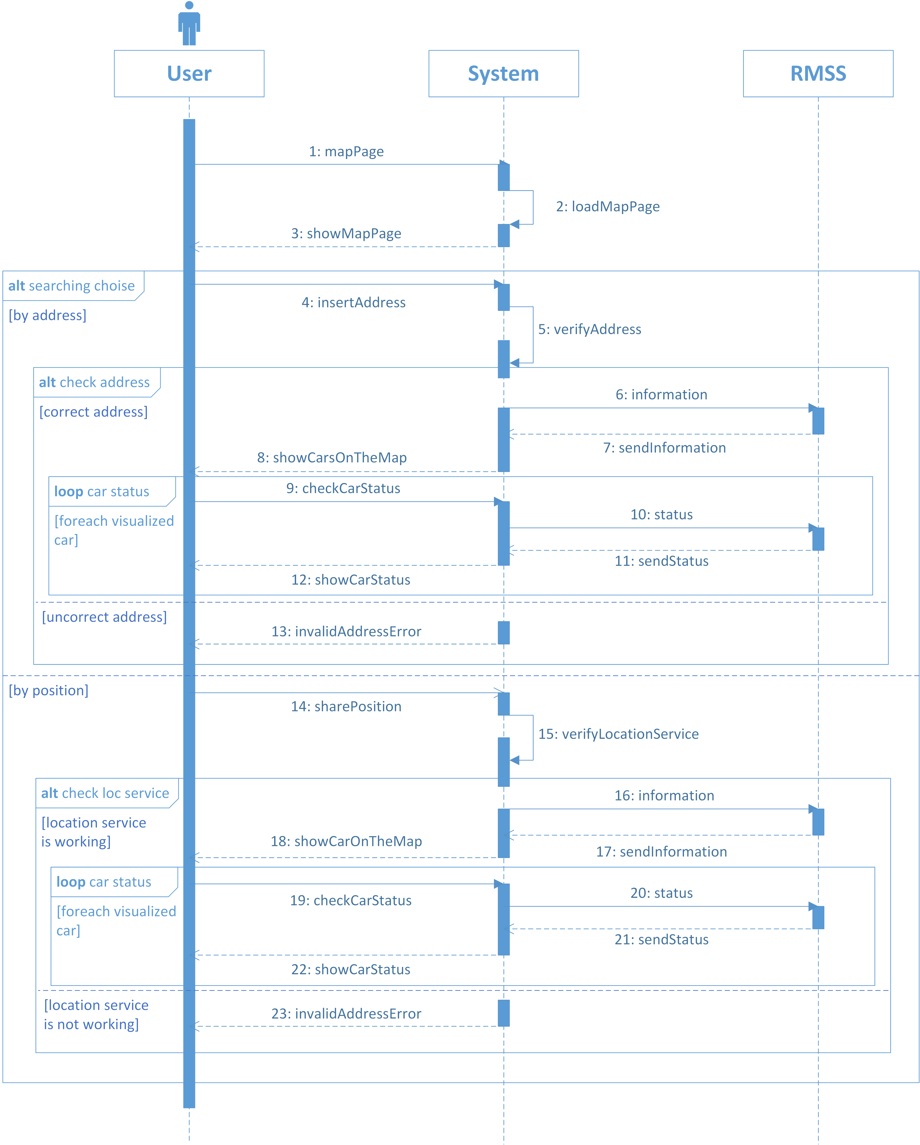

Slide 37
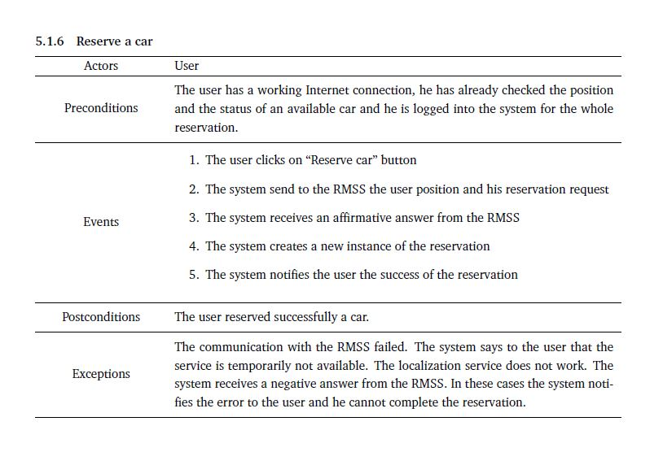

Slide 38
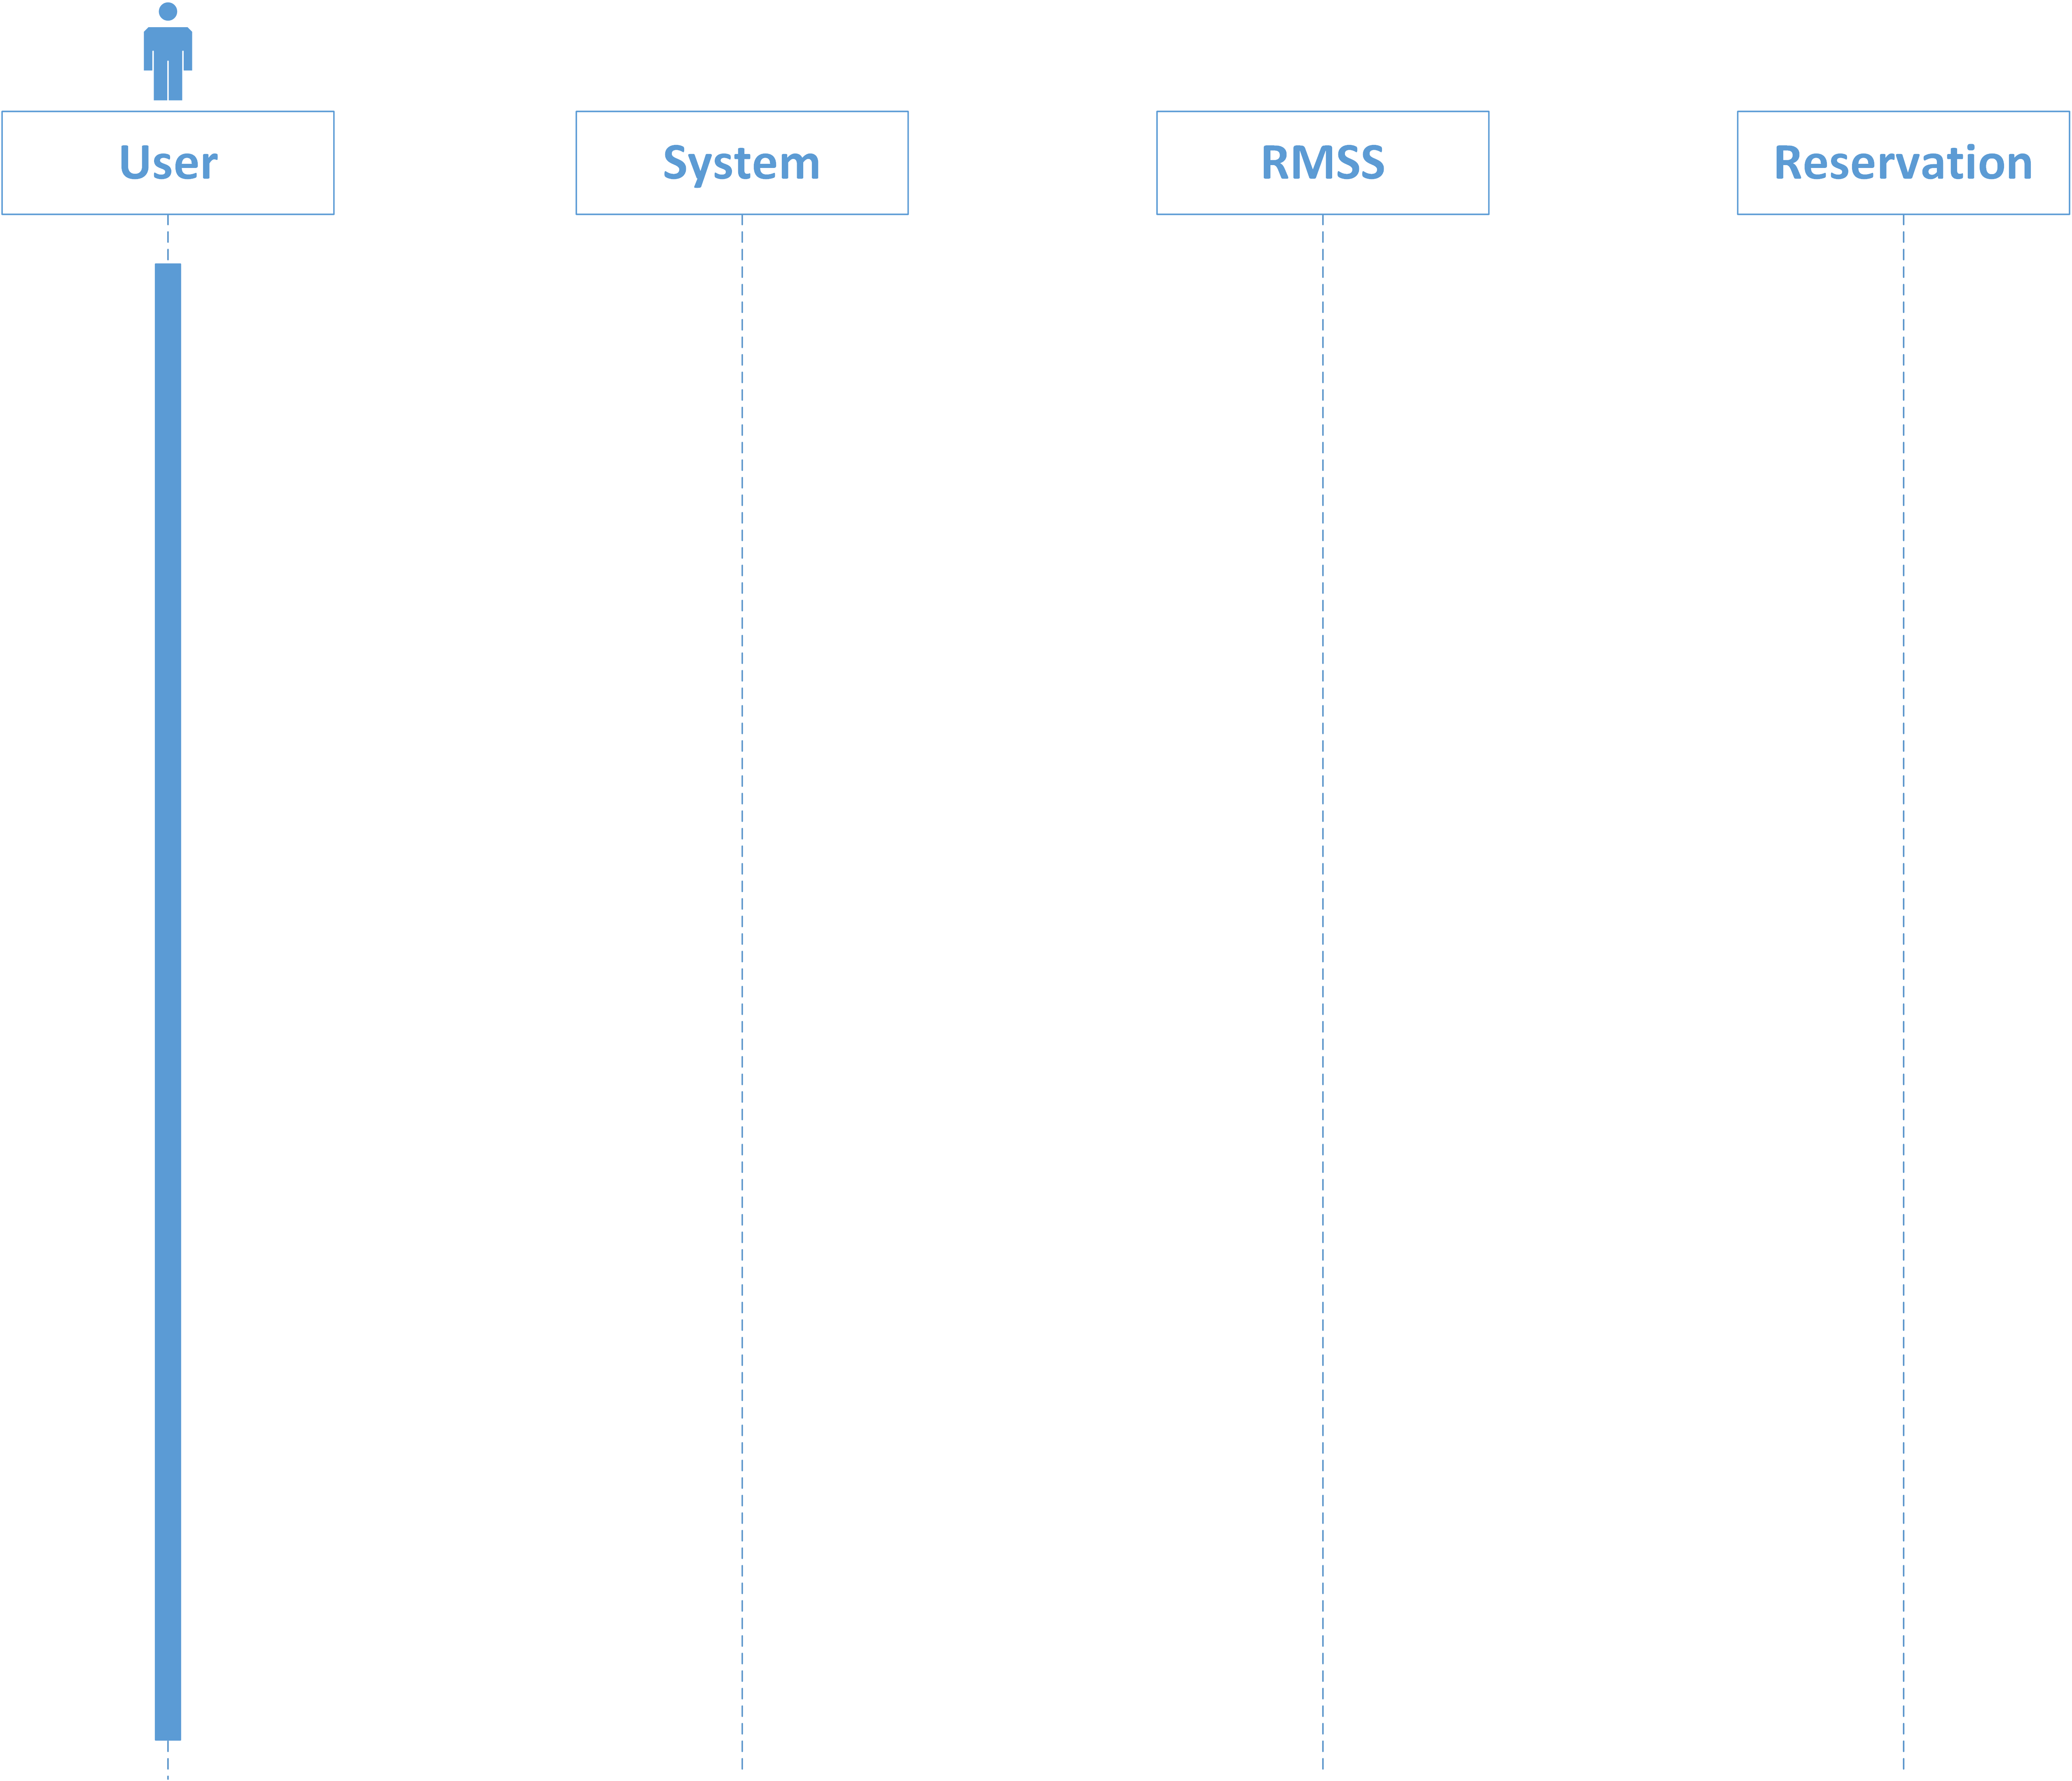

Slide 39
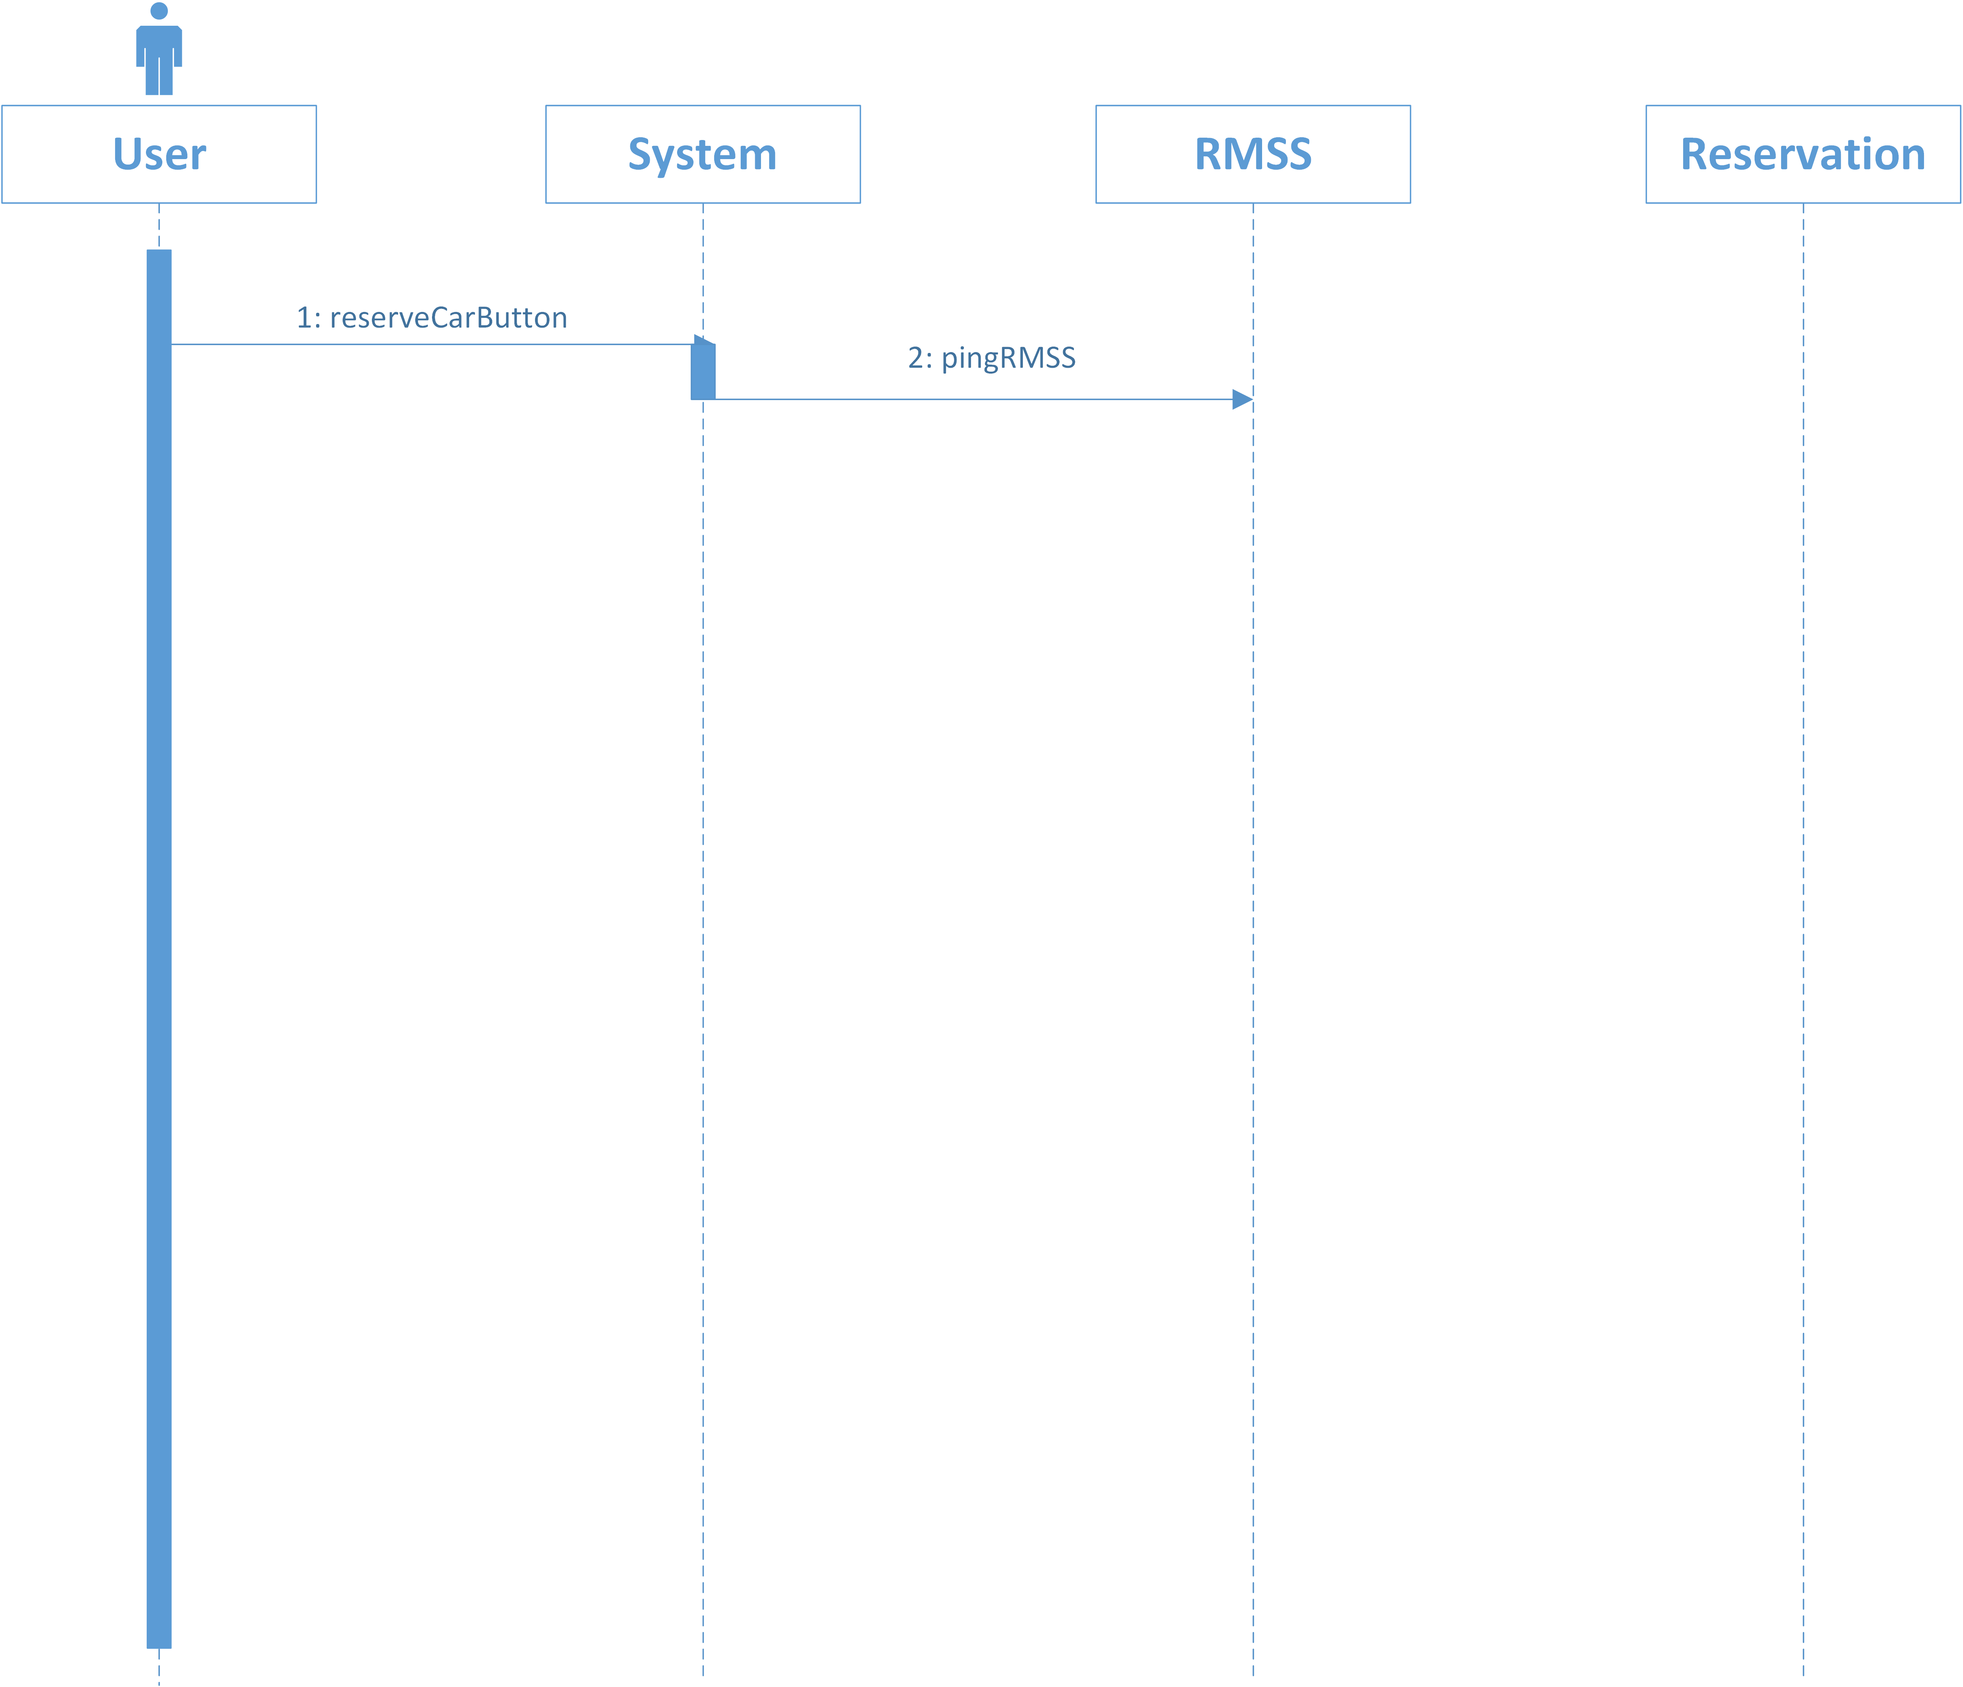

Slide 40
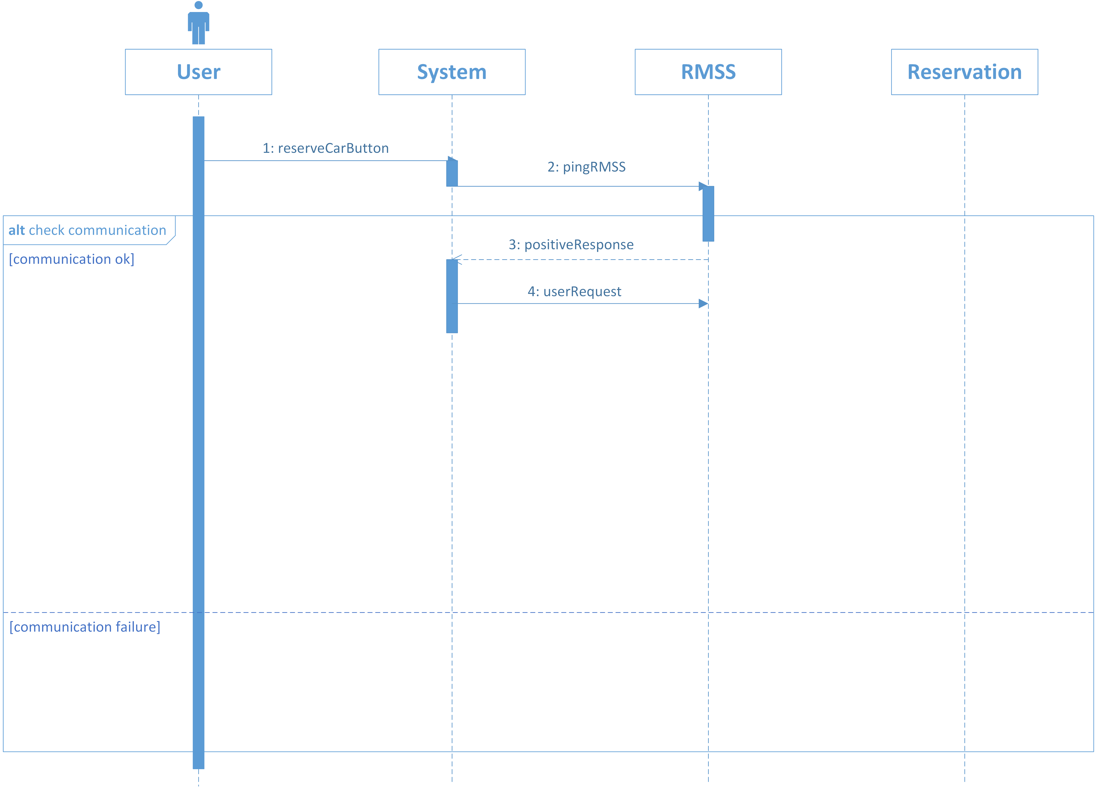

Slide 41
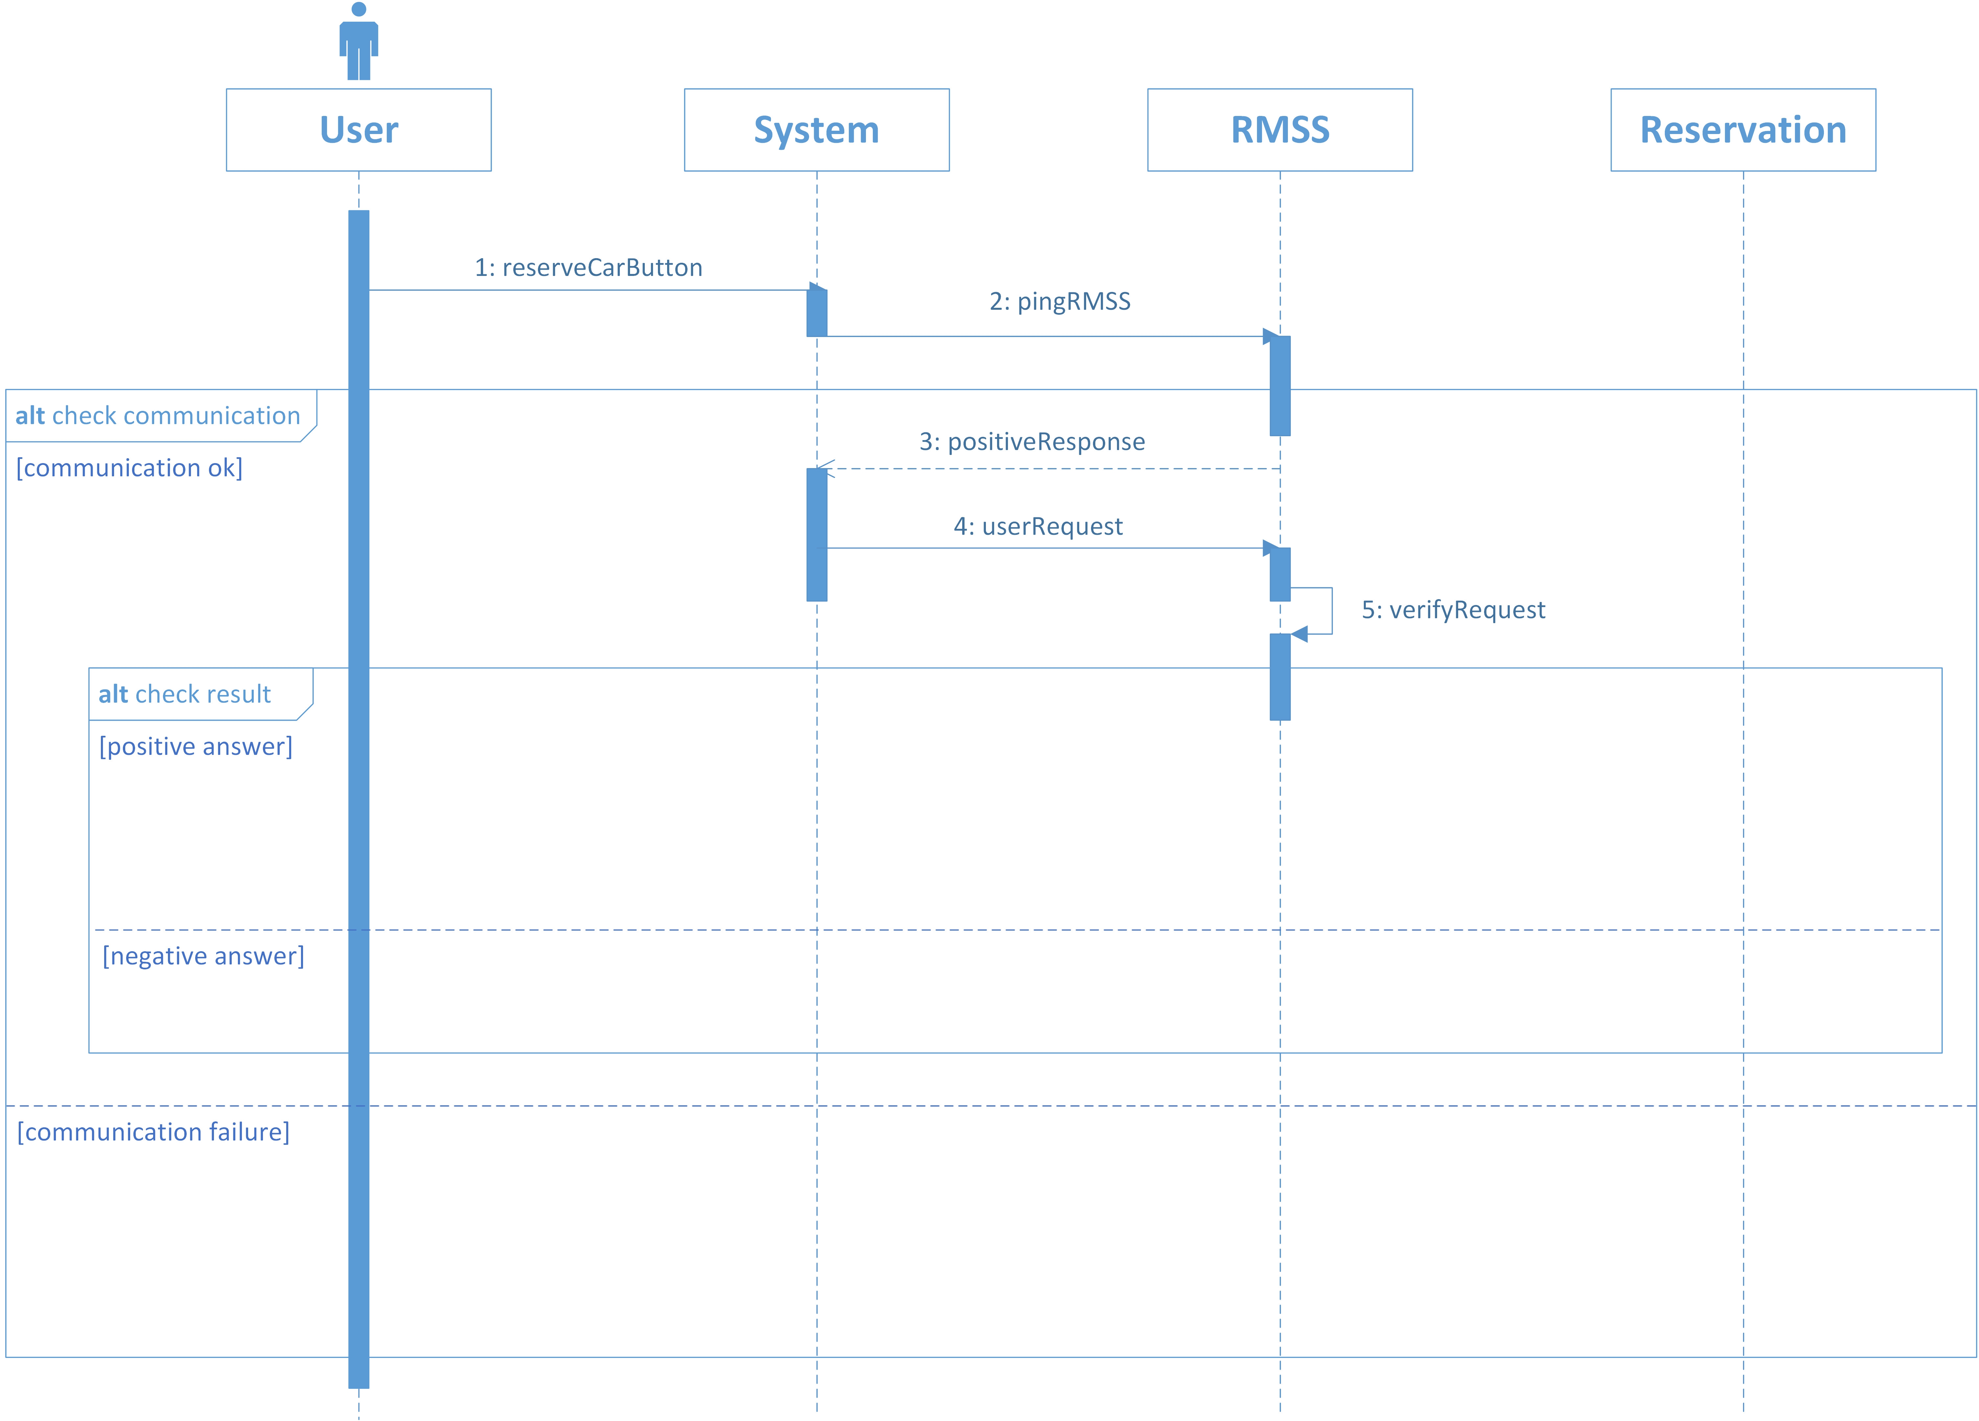

Slide 42
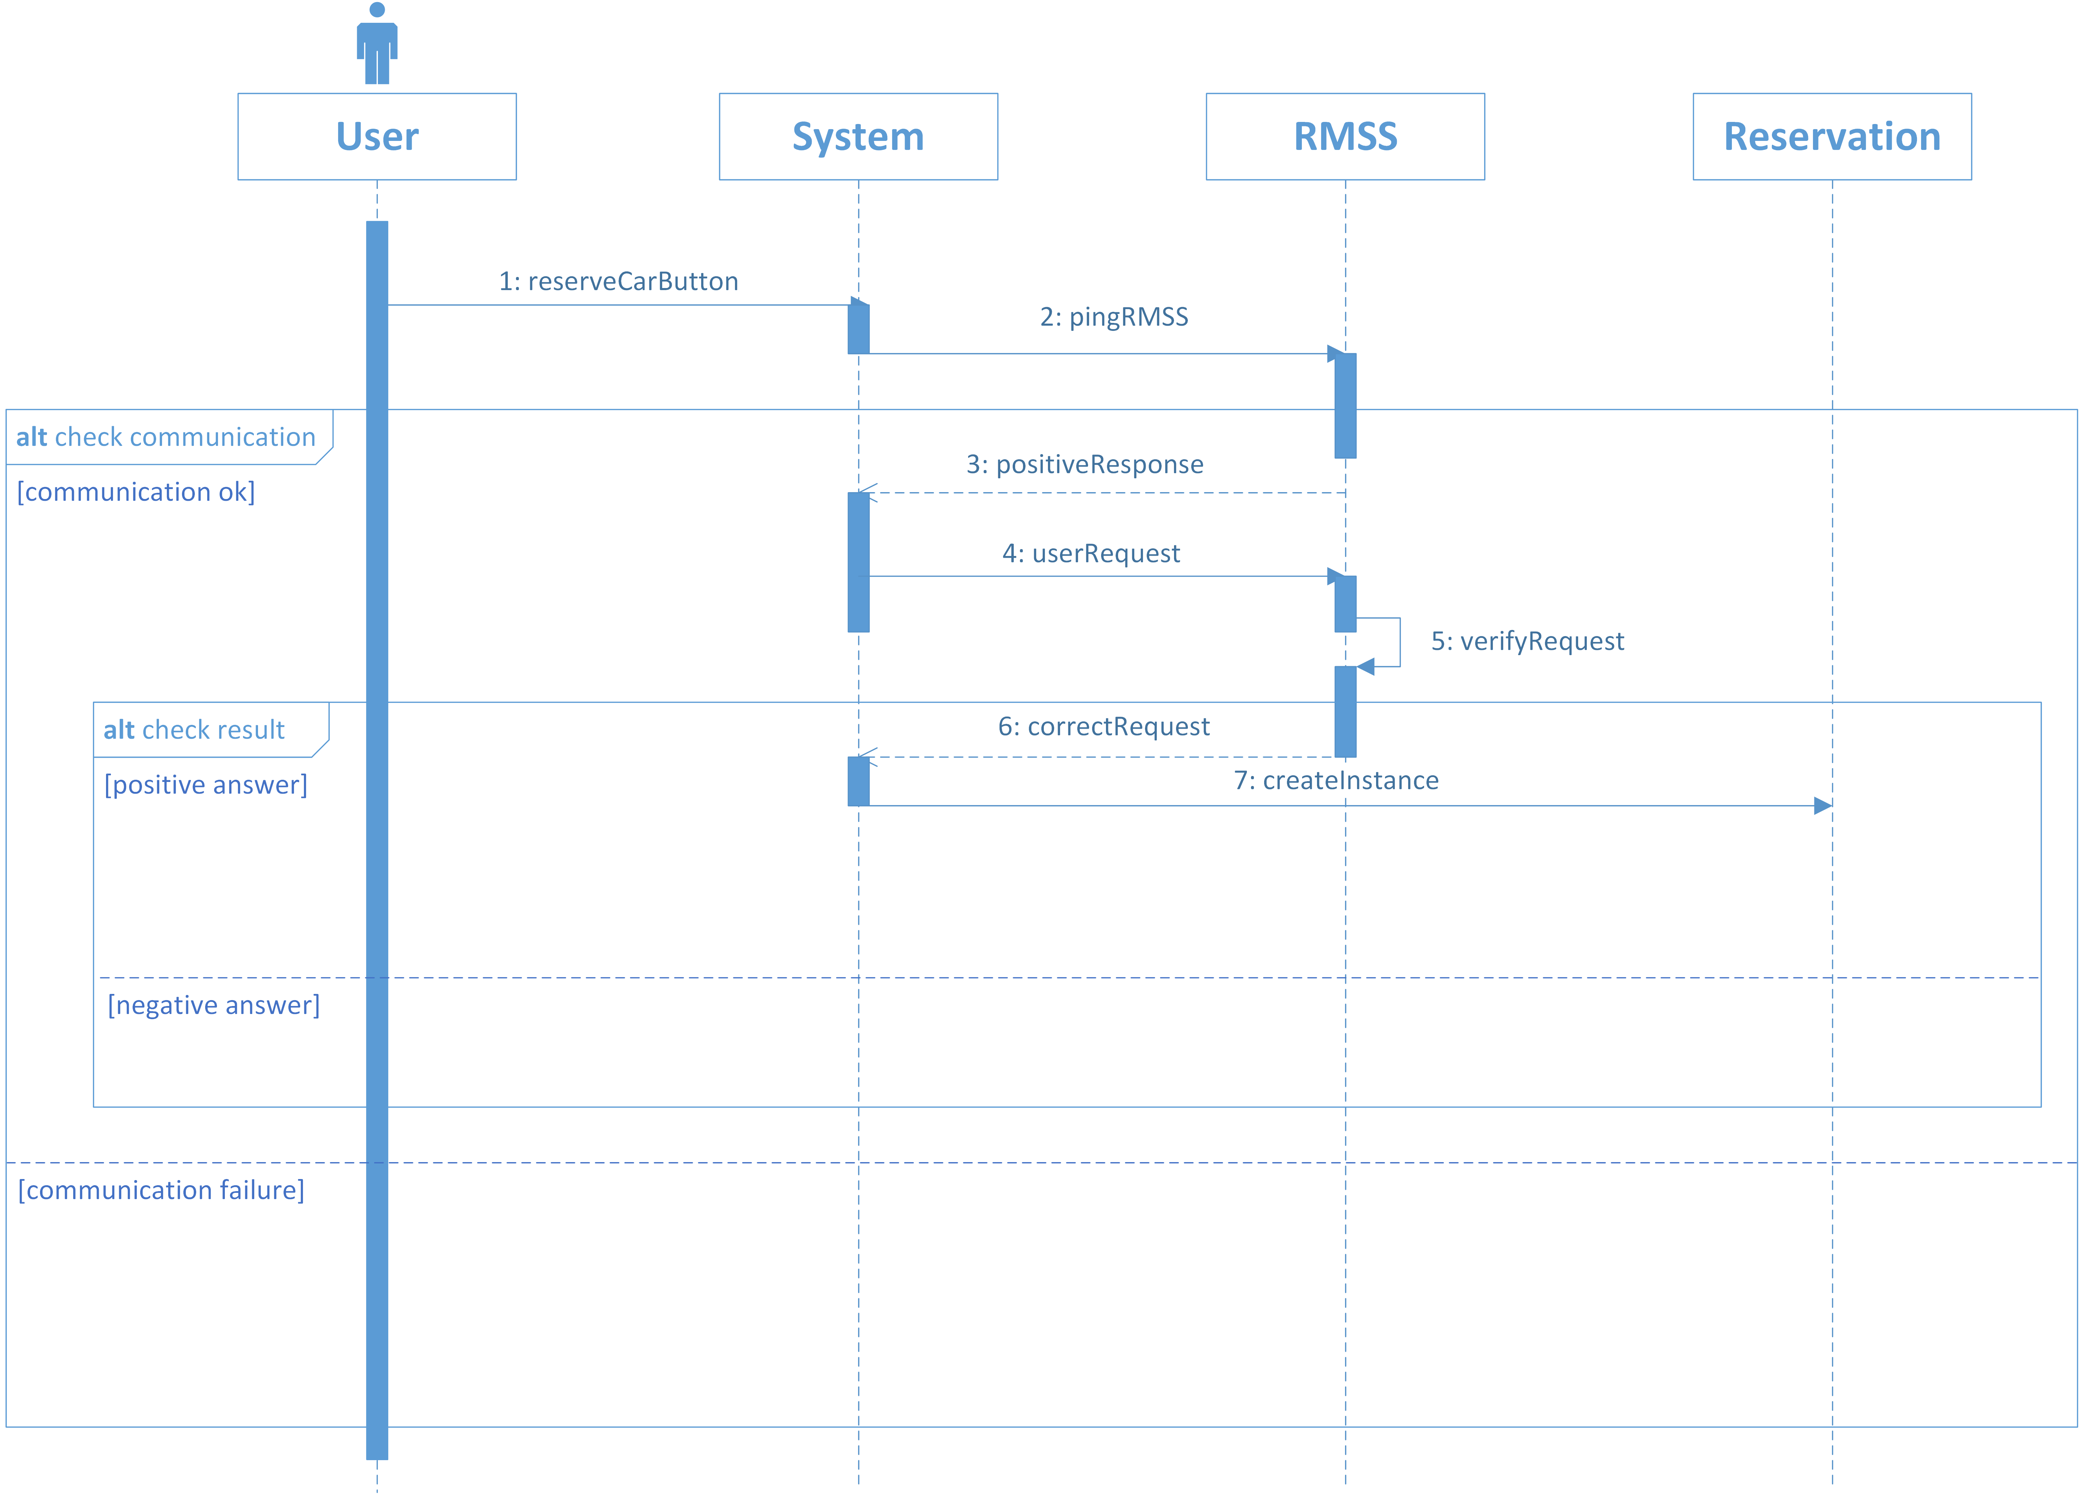

Slide 43
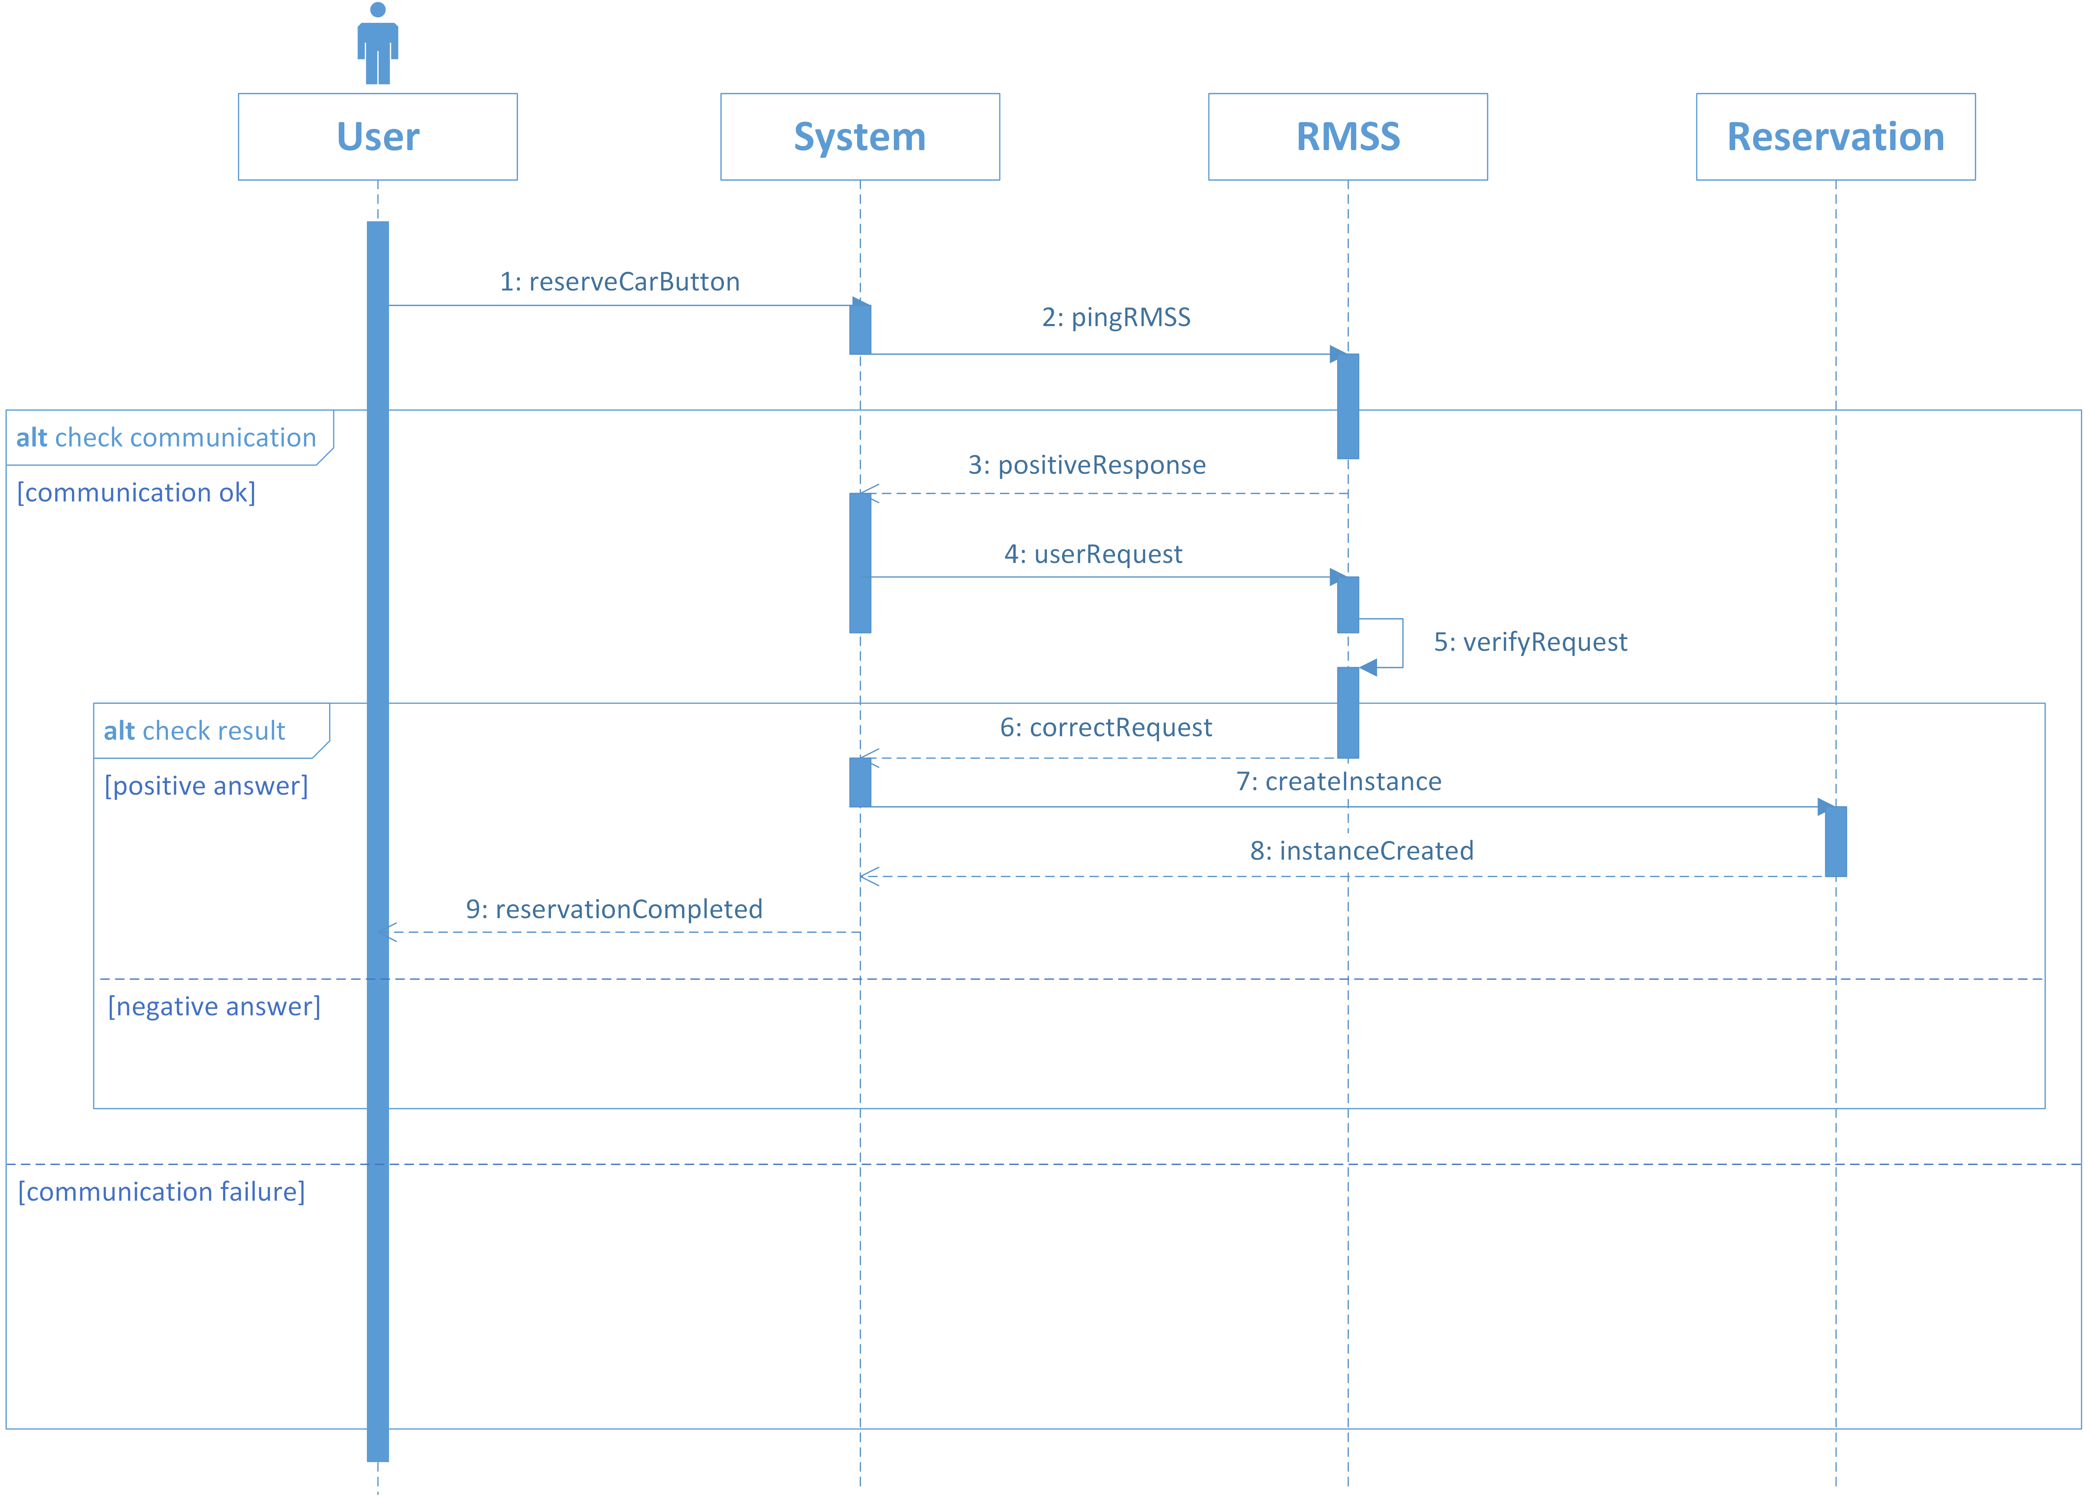

Slide 44
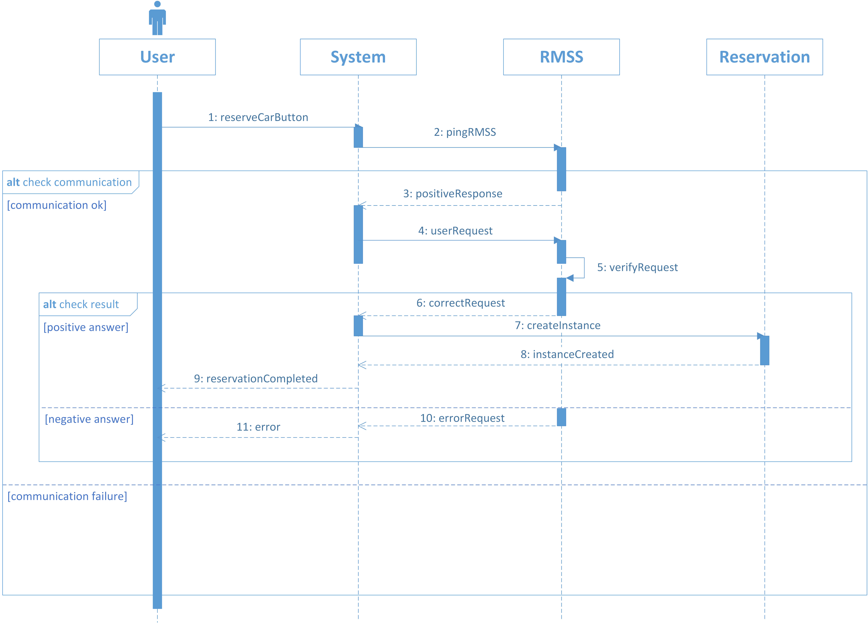

Slide 45
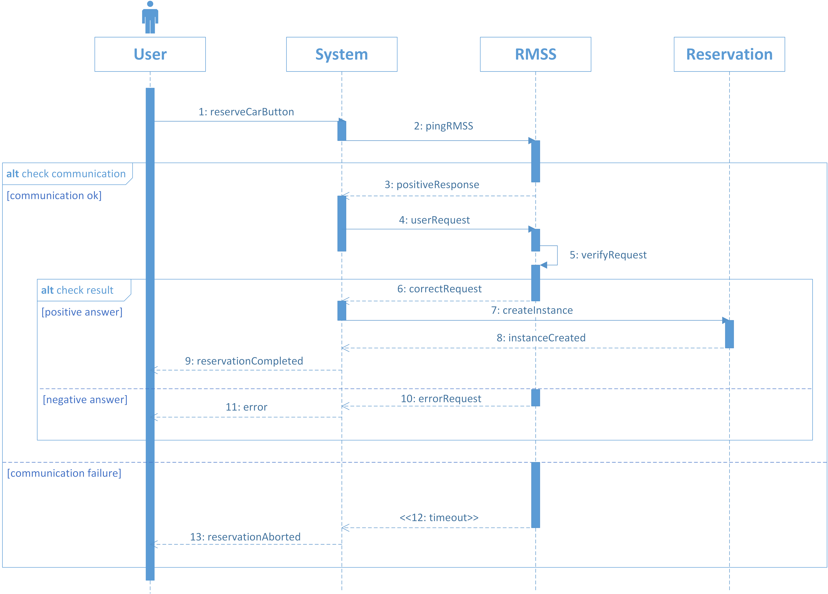

Slide 46
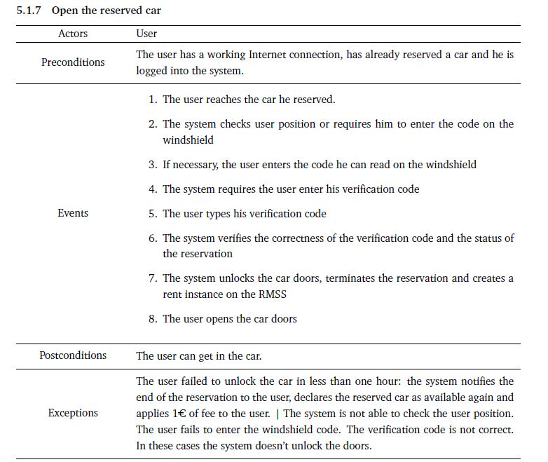

Slide 47
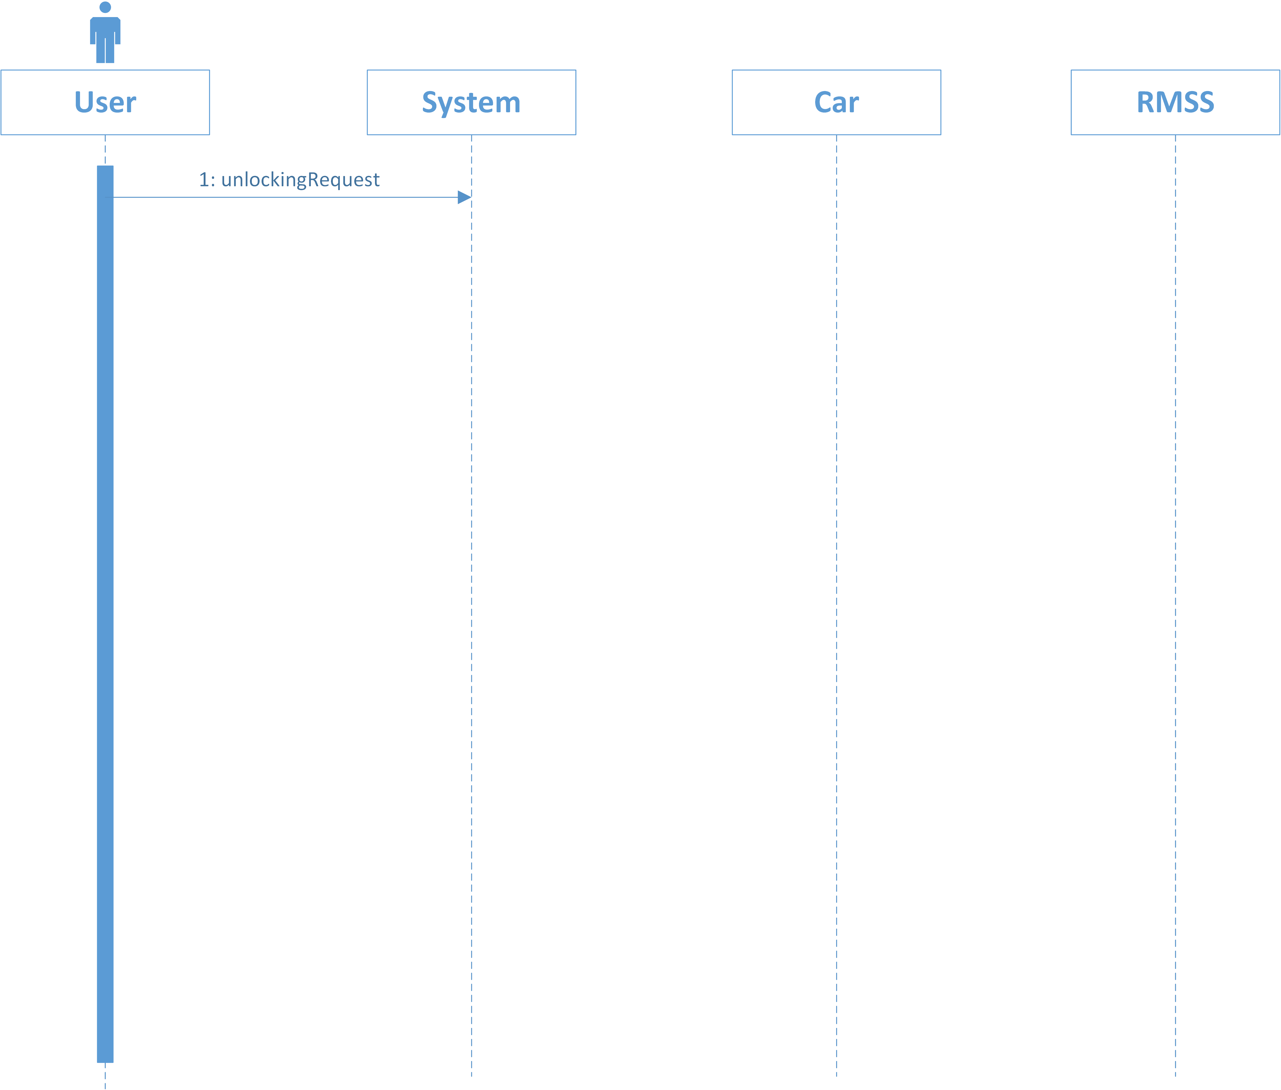

Slide 48
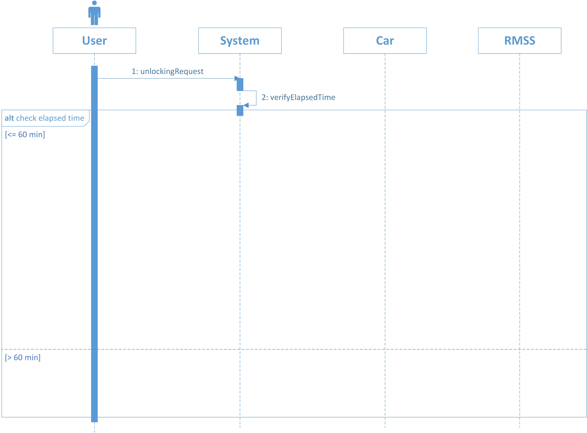

Slide 49
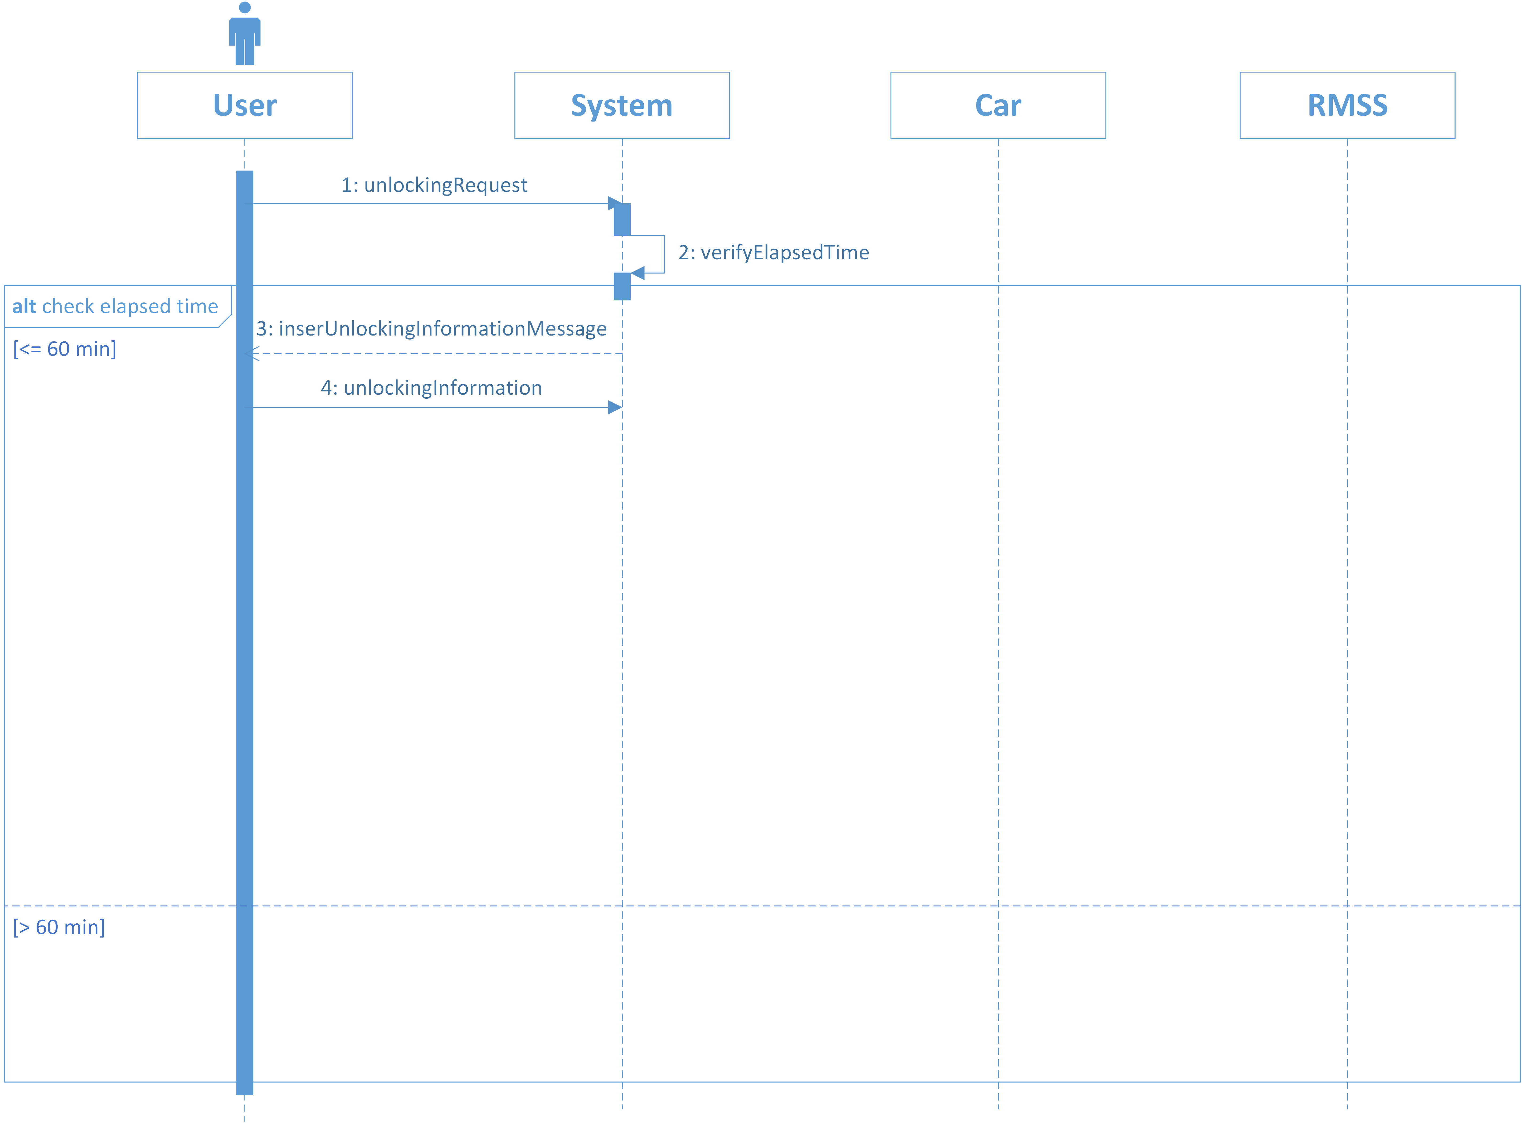

Slide 50
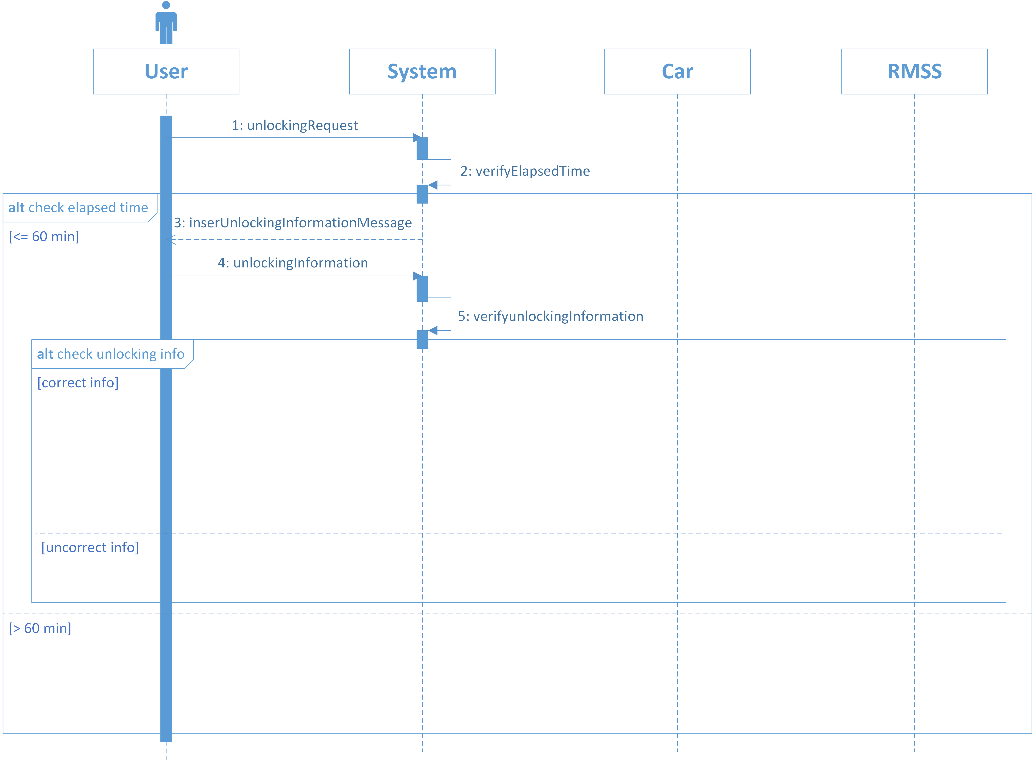

Slide 51
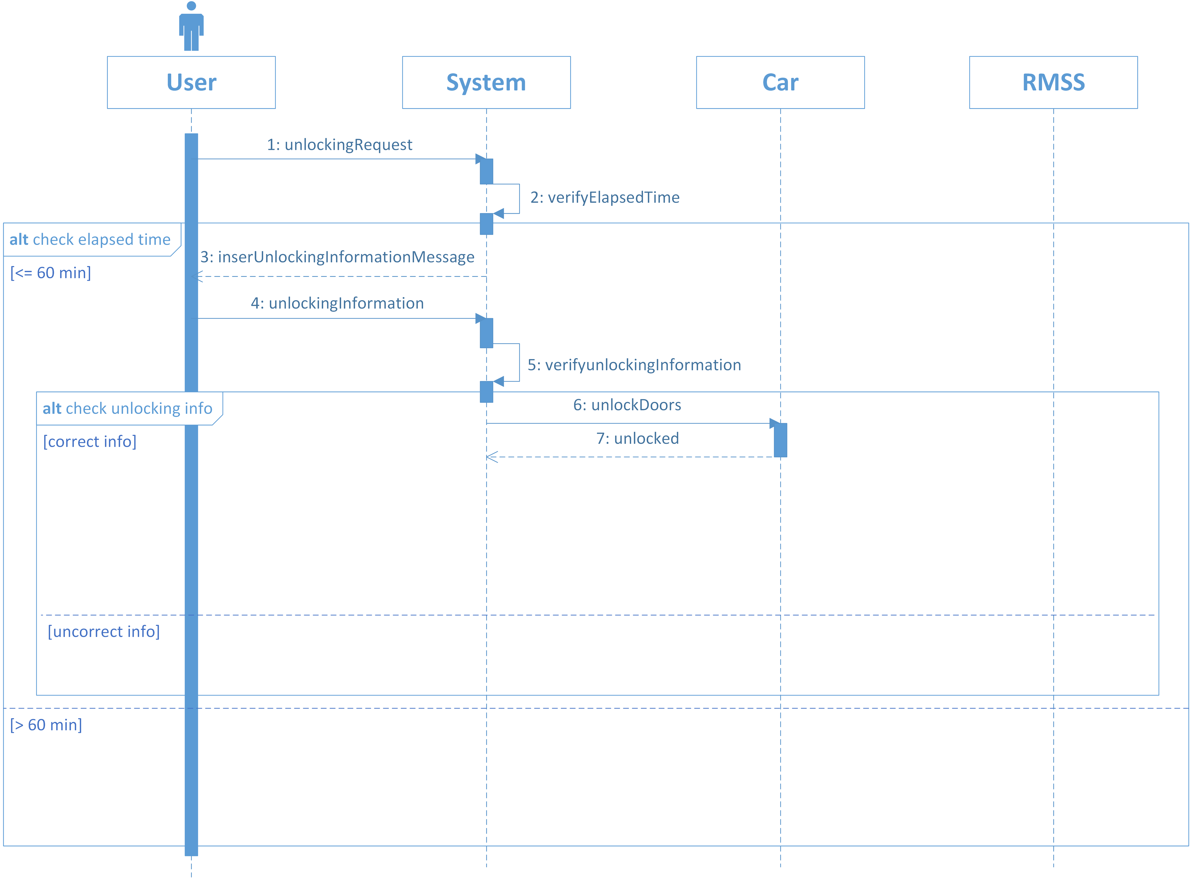

Slide 52
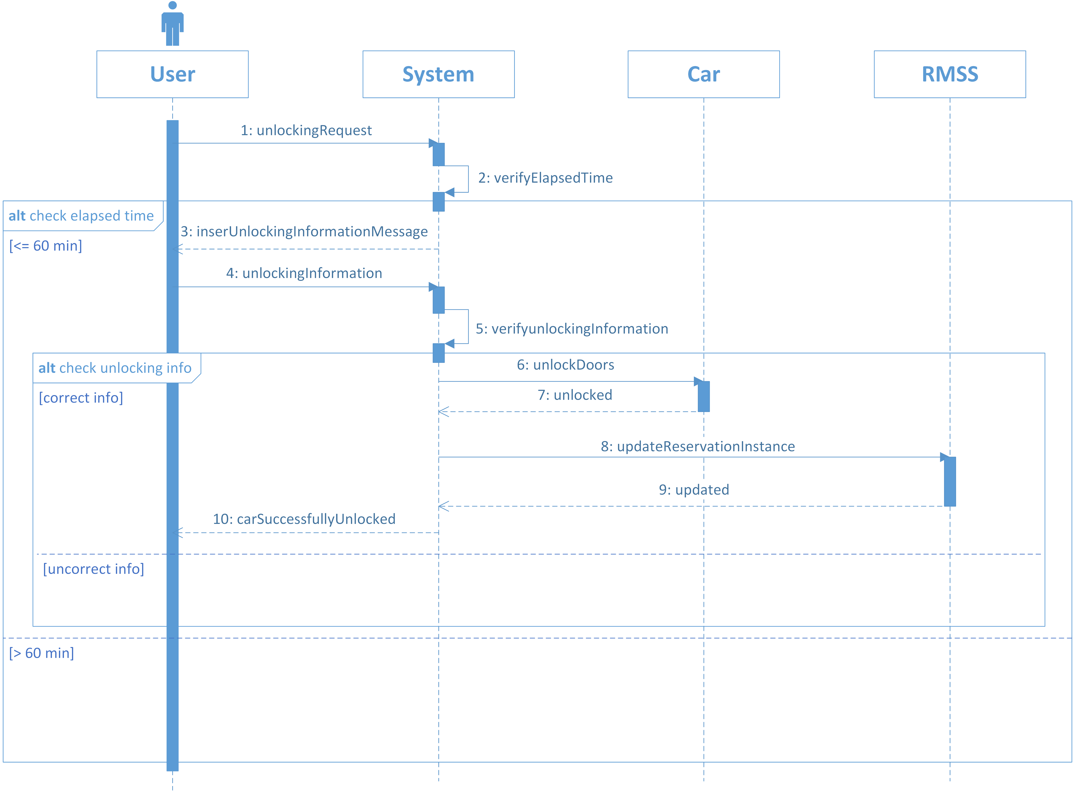

Slide 53
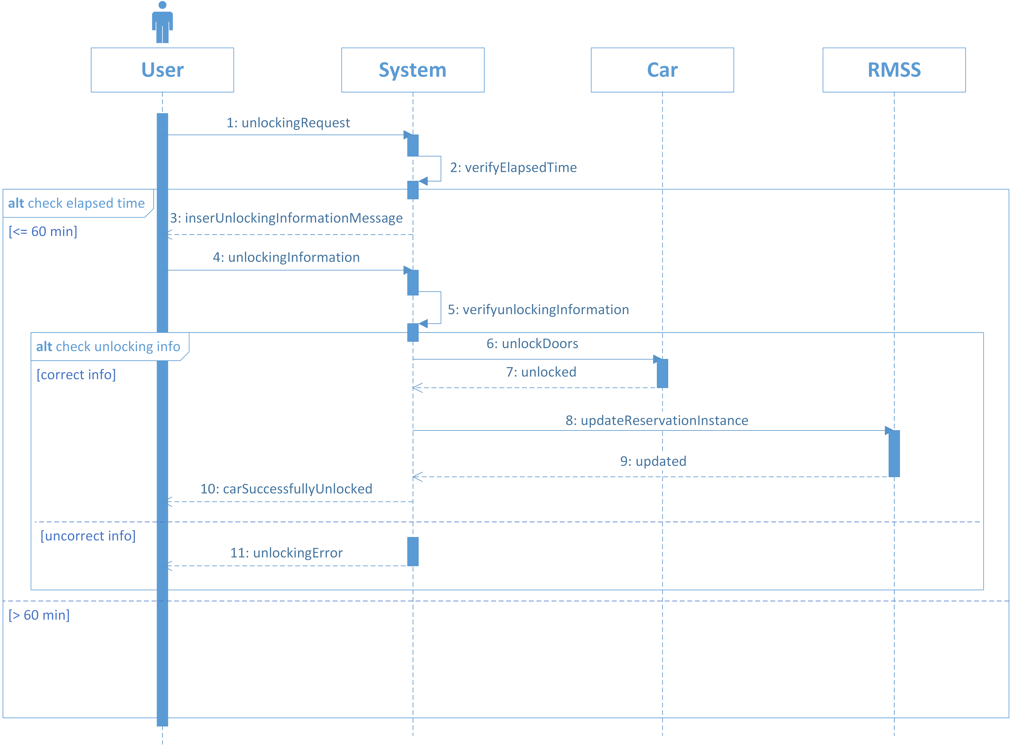

Slide 54
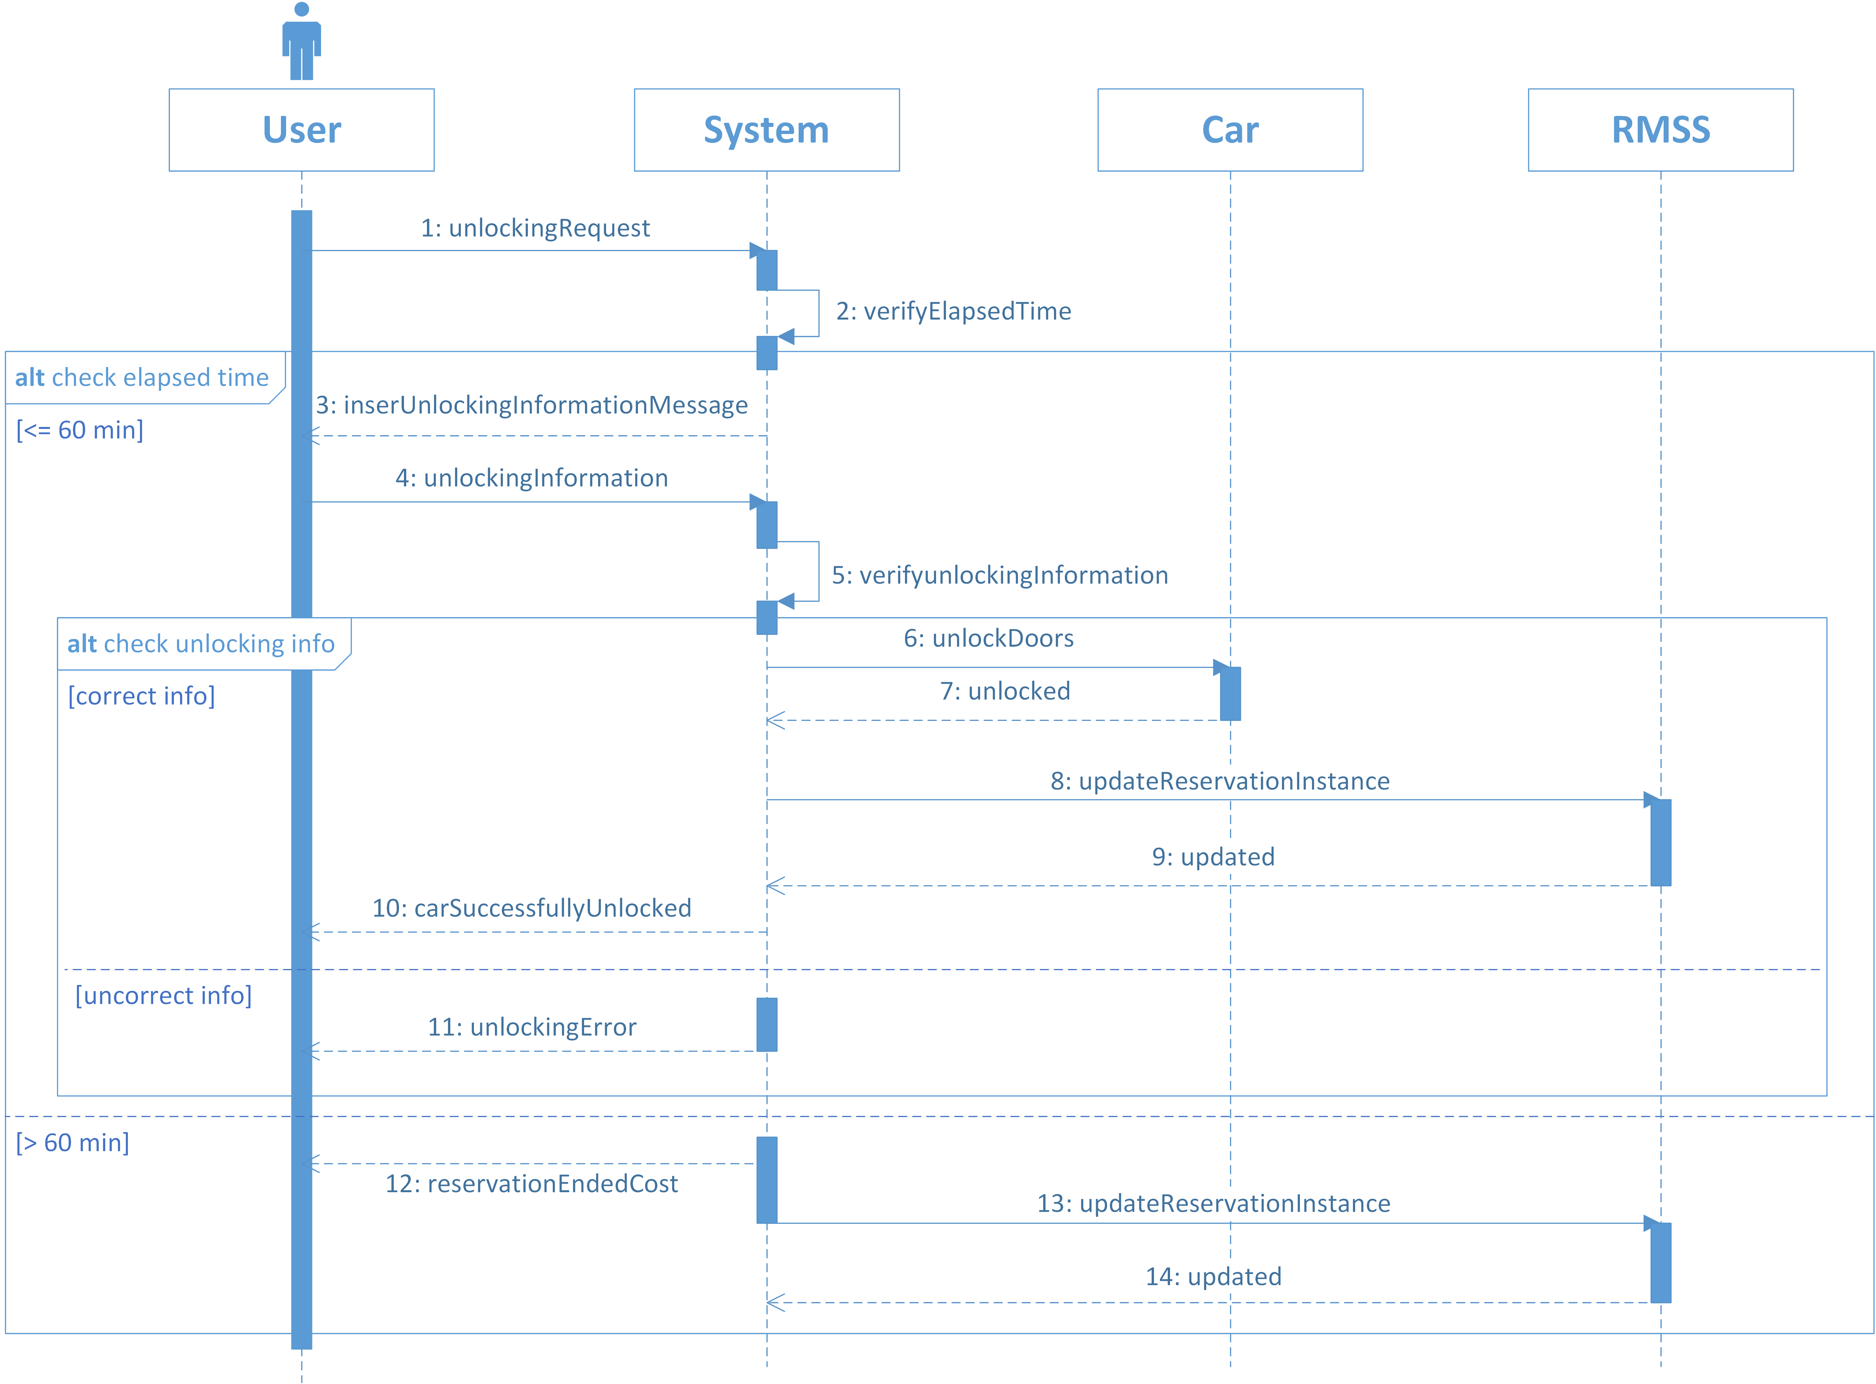

Slide 55
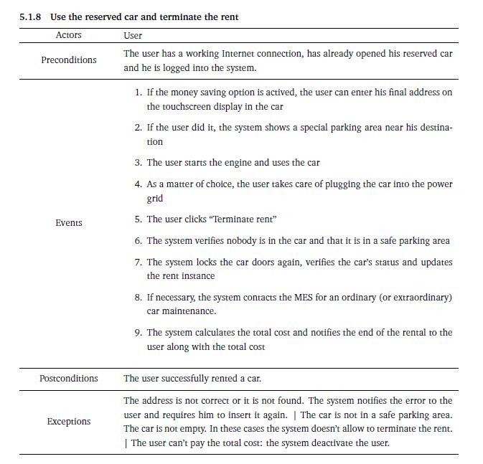

Slide 56
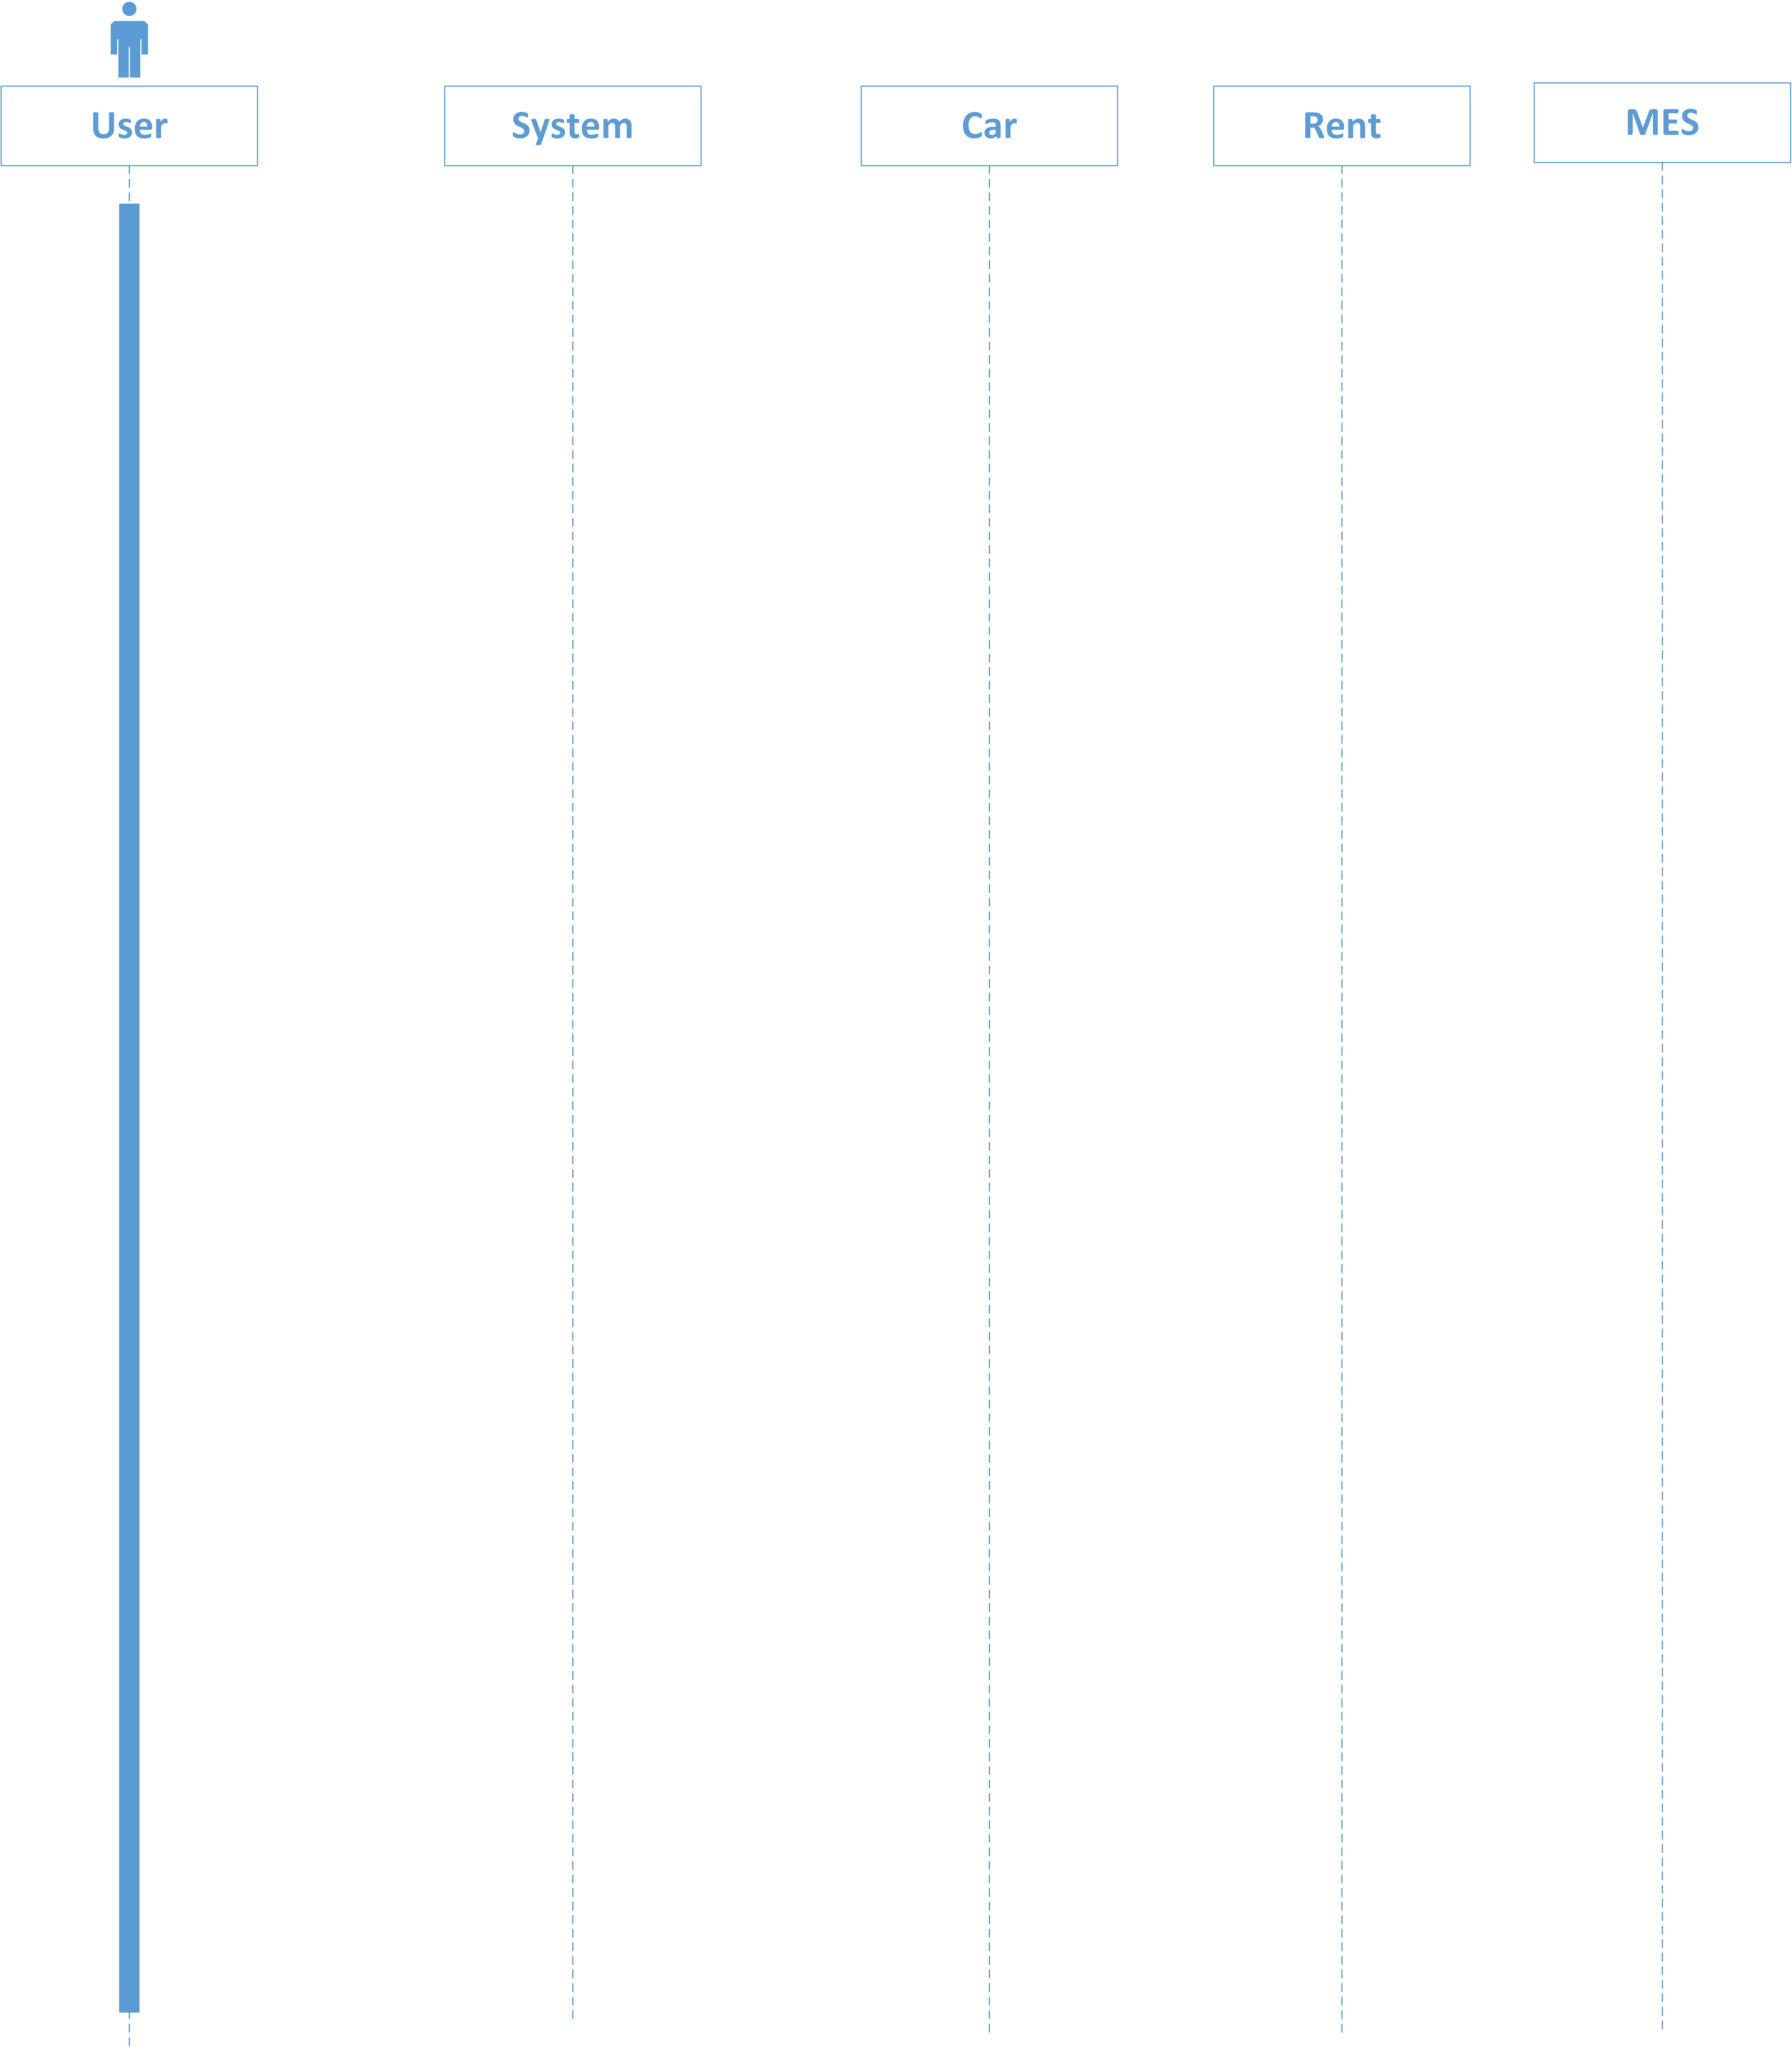

Slide 69
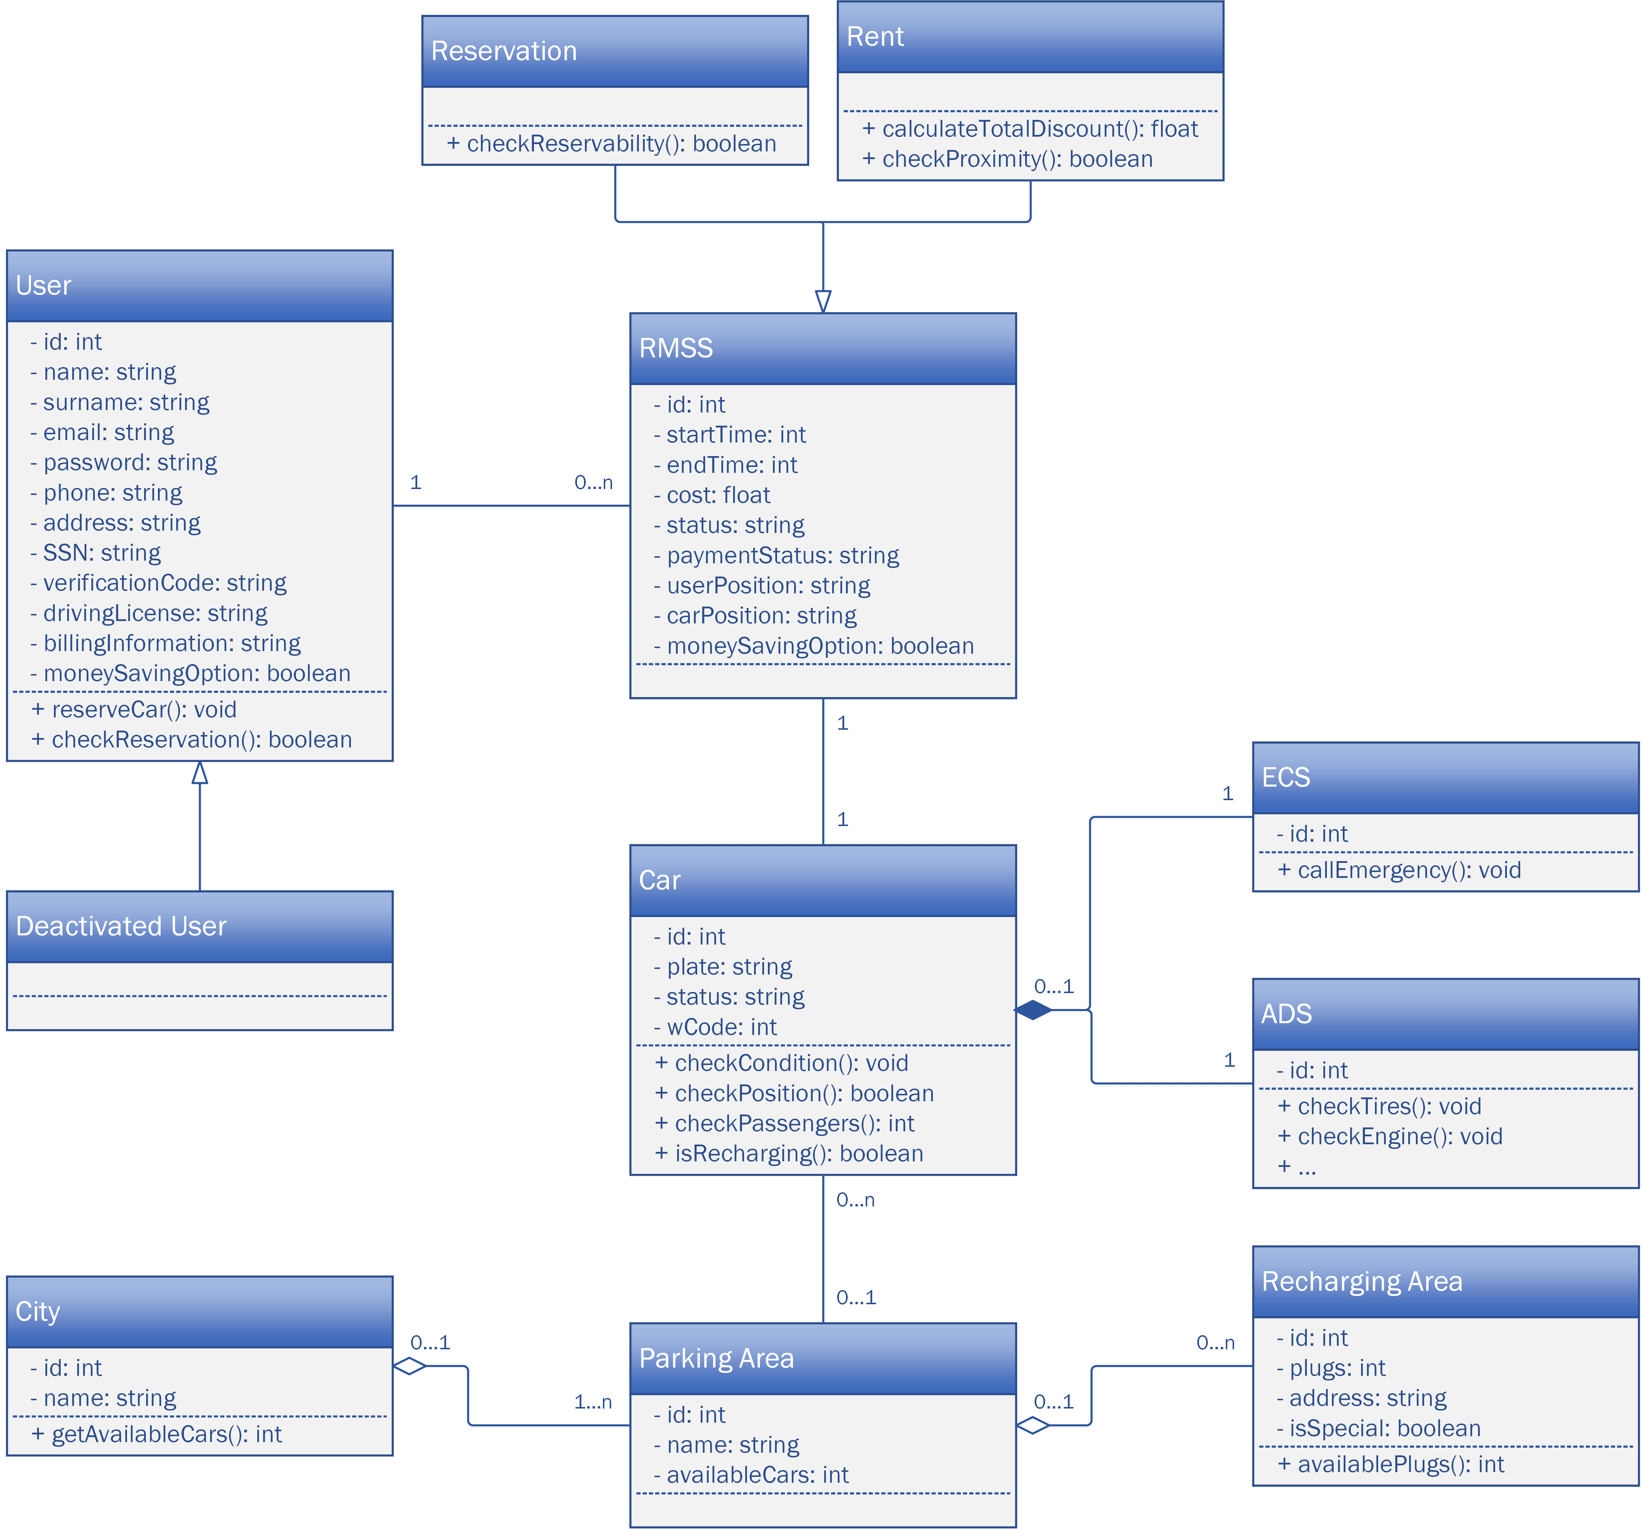
Class Diagram
1 0..n
1
1
1
1
0..n
0..1
0..1 1..n
0..1 0..n

Slide 70
Non-Functional Requirements
The non-functional requirements are those related to the quality of the system to be implemented (Quality of Service, QoS), regardless of the application domain.
Security: each user will only be able to access functionality that competes to his category. It is, therefore, necessary to provide an authentication method: it will be used the symmetric username/password one. Furthermore, each credential will not be stored in clear text, and client/server communications will be protected by asymmetric encryption.
Portability: the system must be compatible with all hardware and software platforms to reach as many users as possible. This requirement could be satisfied, for example, by realizing the system as a web application: in this way the only assumptions that must be met by users are the availability of a web browser and an Internet connection.
Stability and Reliability: The system must notify the user the result of each his/her transaction request while maintaining an optimal level of reliability. Therefore it will be able to face with the possible loss of connection between clients and the central server by ensuring atomicity of all operations.
Performance: the timing of getting the information must be acceptable for the users.
Concurrency Management: the system must ensure data consistency while dealing with multiple concurrent accesses to the same resource by multiple users authenticated to the system.
Graphical User Interfaces (GUIs): The system has to include several graphical user interfaces: intuitive, complete and exceptionally easy to use, that will give the user access to the system’s features.

Slide 71
Functional Requirements
The functional requirements are the functionalities that the system must necessarily have to work properly.
They describe the interactions between the system developed and the external environment independently from the implementation.
Registration of a guest to the system:
(a) The system has to guarantee the registration to a new user by creating a new account.
Login of a user into the system:
(a) The system has to allow the login to an already registered user when he types the correct username and the password in the login form.
Find the location of available cars in a specified area:
(a) The system has to allow both guests and users to specify the address where they want to locate an available car or to use their position;
(b) The system has to guarantee that a car is showed on the map if and only if it is available (that means that every available car is showed and that every showed car is available);
(c) The system has to guarantee that the car’s position is regularly showed up to date.

Slide 72
Functional Requirements
Book a car with the possibility to cancel the reservation:
(a) The system has to guarantee that only a user (i.e. not a guest) can reserve a car;
(b) The system must be able to check the position of the user;
(c) The system has to ensure that the same car cannot be reserved at the same time by different users;
(d) The system has to guarantee that any user can have at most an active reservation;
(e) When a reservation is activated, the system starts a countdown at the end of which the reservation
expires if the user did not pick-up the reserved car;
(f) The system has to guarantee that every reservable car is available;
(g) The system has to ensure that only a reservable car can be reserved;
(h) The system has to guarantee that when a user reserves a car, the latter is no more available;
(i) The system has to ensure that only an active reservation can expire or be canceled;
(j) The system has to make sure that when a reservation expires or is revoked, the car becomes available again;

Slide 73
Functional Requirements
Open his/her reserved car;
(a) The system must be able to check the proximity of the user to the reserved car;
(b) The system must be able to check if the money saving option is enabled for the current reservation;
(c) The system has to allow the user to insert the verification code;
(d) The system has to unlock the reserved car only if the entered verification code is correct.
End the rental:
(a) The system has to allow the user to communicate that he/she wants to terminate the rental;
(b) The system has to allow the user to end the rental only if he is in a safe parking area;
(c) The system has to guarantee that when a reservation is ended, the car becomes available again.

Slide 74
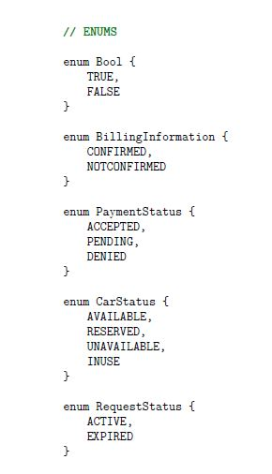
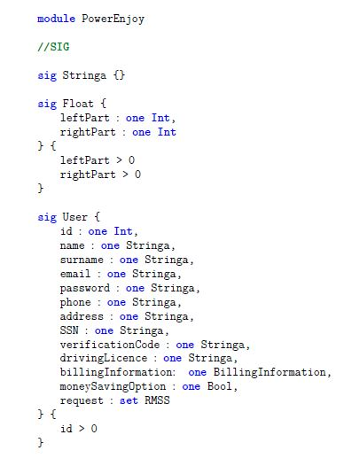
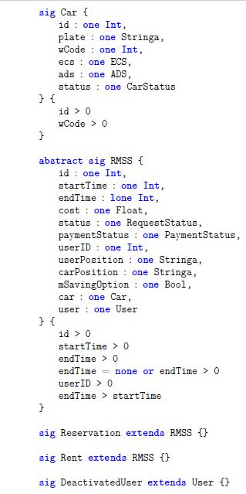
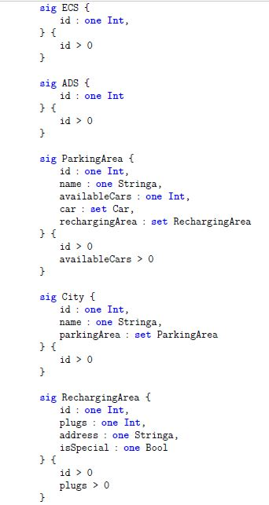
Alloy

Slide 75
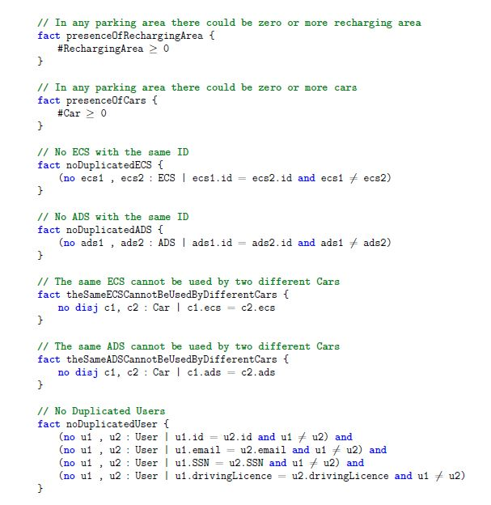
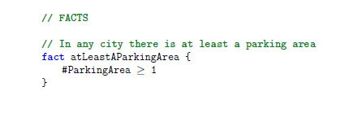
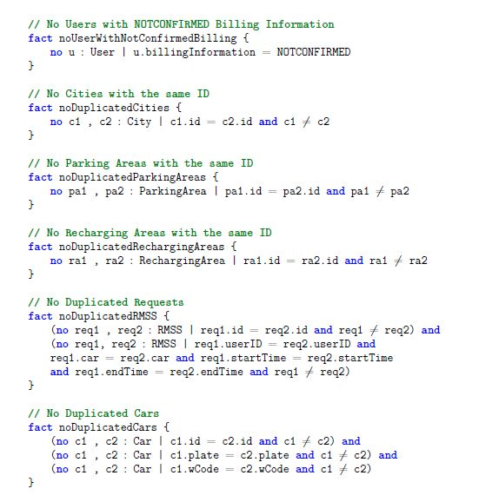
Alloy

Slide 76
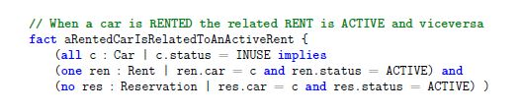
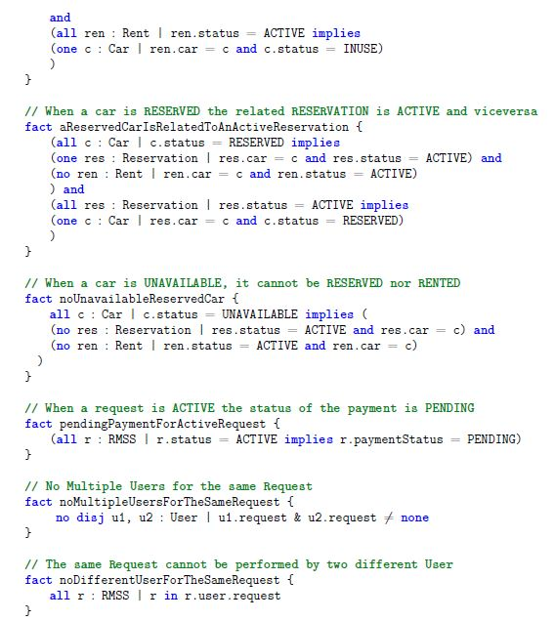
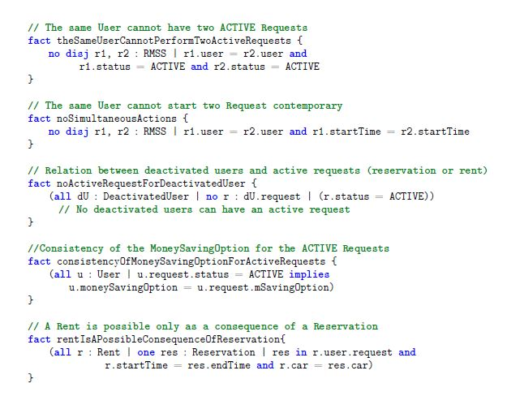
Alloy

Slide 77
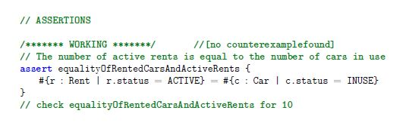

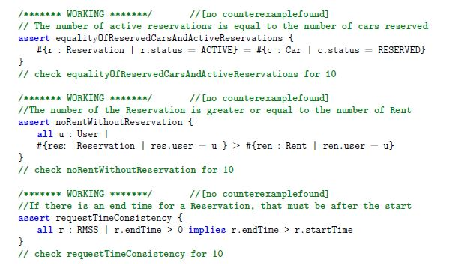

Alloy
Traditional Code
Testing Activities
[random research in a infinite domain]
VS
Small Scope Hypotesys
[exhaustive research in a finite subset of the domain.]

Slide 78

Authors:
_Giancarlo Colaci
_Giulio De PASQUALE
_Francesco Rinaldi
Thank you all!

